Slide 1
Introduction to Java

Slide 2
A class-based, object-oriented programming language.
Developed by James Gosling at Sun Microsystems Inc in the year 1995 and later acquired by Oracle Corporation.
Used to develop mobile apps, web apps, desktop apps, Games and more.
One of the most popular programming language in the world.
Has a huge community support

Slide 3
Features/ Buzz Words
Simple
Object-Oriented
Platform independent
Portable
Secured
Robust
Interpreted
High Performance
Multithreaded
Distributed
Dynamic

Slide 4
Simple
Java is very easy to learn, and its syntax is simple, clean and easy to understand.
According to Sun Microsystem, Java language is a simple programming language because:
Java syntax is based on C++.
Java has removed many complicated and rarely-used features, for example, explicit pointers, operator overloading, etc.
There is no need to remove unreferenced objects because there is an Automatic Garbage Collection in Java.

Slide 5
Object-oriented
Everything in Java is an object.
We organize our software as a combination of different types of objects that incorporate both data and behavior.
Basic principle of OOPs are:
Inheritance
Polymorphism
Abstraction
Encapsulation

Slide 6
Platform independent
Can be easily executed on any operating system
It achieves platform independence through the Java Virtual Machine (JVM)
Java code is compiled by the compiler and converted into bytecode. This bytecode can be run on any platforms having JVM
Portable
We can carry java bytecode and run in any platform
It’s possible because of its platform independence
Write Once Run Anywhere (WORA)

Slide 7
Secure
No explicit pointer to access memory location
Java Programs run inside a virtual machine sandbox
Robust
Java uses strong memory management with automatic garbage collection
Lack of pointers that avoids security problems
Java provides exception handling.
Strongly typed language

Slide 8
Architecture-neutral
Java is architecture neutral because there are no implementation dependent features.
In C programming, int data type occupies 2 bytes of memory for 32-bit architecture and 4 bytes of memory for 64-bit architecture. However, it occupies 4 bytes of memory for both 32 and 64-bit architectures in Java.
Distributed
Java facilitates users to create distributed applications in Java.
RMI and EJB are used for creating distributed applications.
This feature of Java makes us able to access files by calling the methods from any machine on the internet.

Slide 9
Multi-threaded
A thread is like a separate program, executing concurrently.
We can write Java programs that deal with many tasks at once by defining multiple threads.
Java allows concurrent execution of two or more parts of a program for maximum utilization of the CPU.
High Performance:
Java is faster than other traditional interpreted programming languages because Java bytecode is "close" to native code.
Still slower than c and c++ (Compiled to platform specific)

Slide 10
Dynamic
It supports the dynamic loading of classes. It means classes are loaded on demand.
Java supports dynamic compilation.
It support automatic memory management (garbage collection).
Interpreted
In programming languages, programs use either the compiler or an interpreter
But, Java uses both a compiler and an interpreter.
Java programs are compiled to generate bytecode files then JVM interprets the bytecode file during execution

Slide 11
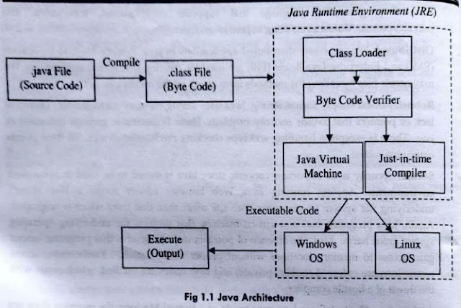
Java Architecture

Slide 12
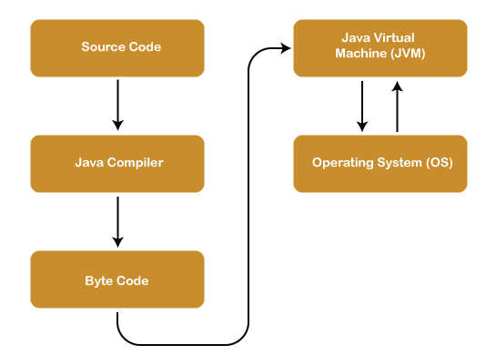

Slide 13
Components of Java Architecture
Java Virtual Machine (JVM)
JVM is an abstract machine that provides the environment in which Java bytecode is executed.
Java Runtime Environment (JRE)
It provides an environment in which Java programs are executed. JRE takes our Java code, integrates it with the required libraries, and then starts the JVM to execute it.
Java Development Kit (JDK)
It is a software development environment used in the development of Java applications
Java Development Kit holds JRE, a compiler, class loader

Slide 14
First Java Program
public class HelloWorld {
public static void main(String[] args) {
System.out.println("Hello World");
}
}

Slide 15
Understanding the program
Class declaration: public class HelloWorld
HelloWorld is our className
Keyword ‘class’ is used to declare a class
Keyword ‘public’ is used to determine the class is accessible from anywhere
Class containing main method should be public as it needs to be accessed from JVM.
Main method: public static void main(String[] args)
main is our method name
Keyword ‘static’ is used to access the main method without object creation
Keyword ‘void’ mean the the method will not return anything
‘String[] args’ means main method argument
Print statement: System.out.println()
out is static variable of type PrintStream
The System class contains several useful class fields and methods for standard input, output

Slide 16
Running a Java Program
Compile:
Open the terminal and navigate to the folder where java code is written
Run the following command
javac HelloWorld.java
Executing the code
Run the following command
Java HelloWorld

Slide 17
Data types in Java
Primitive Data Types
Non primitive Data Types ( Reference Data types)

Slide 18
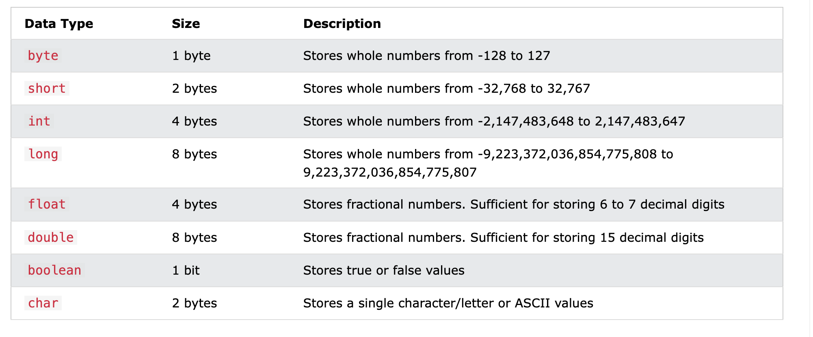
Primitive data type

Slide 19
Non primitive data type
Non-primitive data types can be created or modified by programmers.
All Classes in Java are non-primitive data types
There are four types of Non-Primitive data types in Java
Class
String
Array
Interface

Slide 20
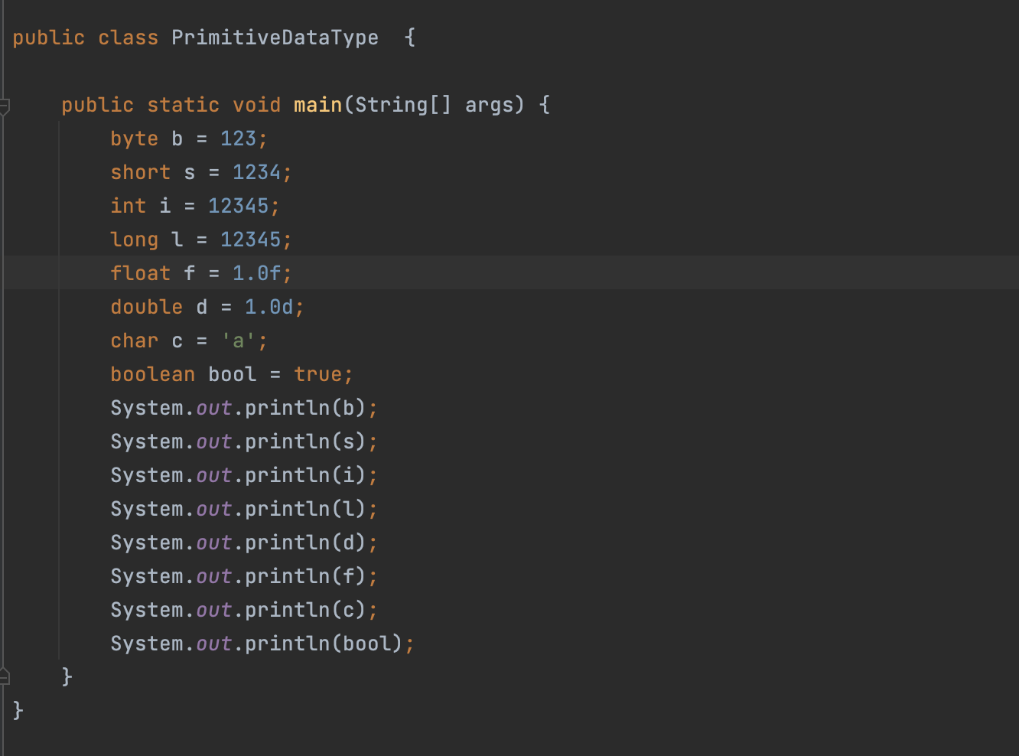

Slide 21
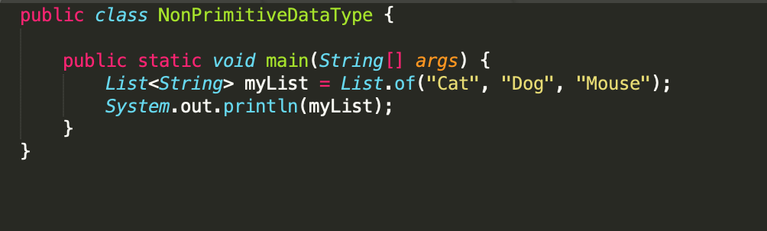

Slide 22
Java Type Casting
Type casting is when you assign a value of one primitive data type to another type.
In Java, there are two types of casting:
Widening Casting (automatically) - converting a smaller type to a larger type size
byte -> short -> char -> int -> long -> float -> double
Narrowing Casting (manually) - converting a larger type to a smaller type
double -> float -> long -> int -> char -> short -> byte

Slide 23
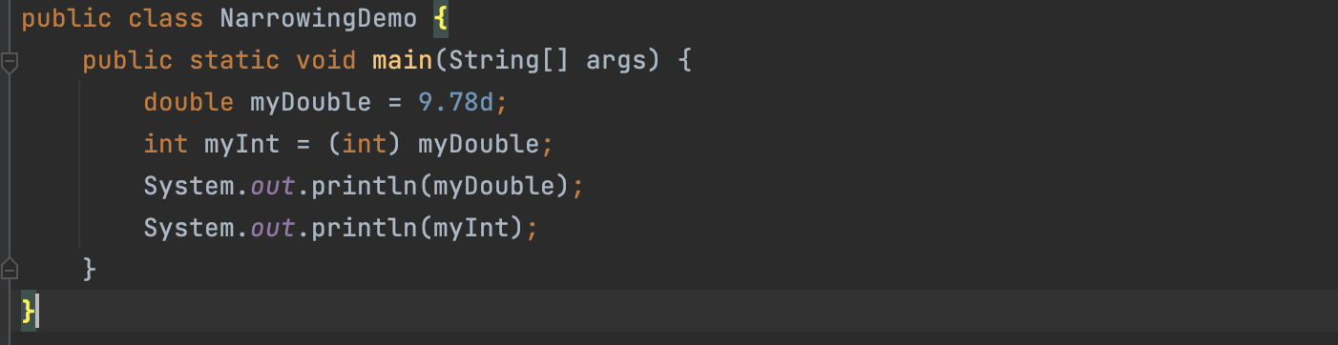

Slide 24
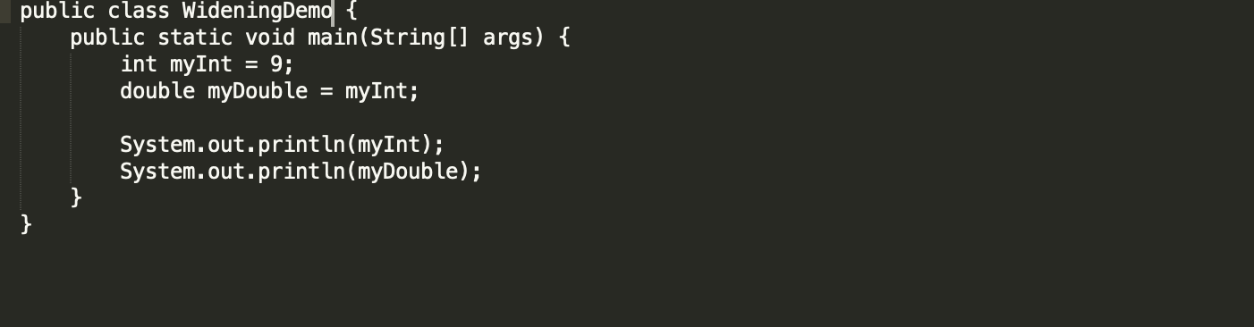

Slide 25
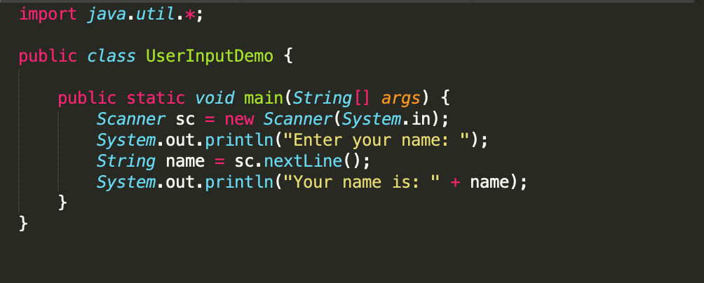
Taking input from user
The Scanner class is used to get user input
It is found in the java.util package.

Slide 26
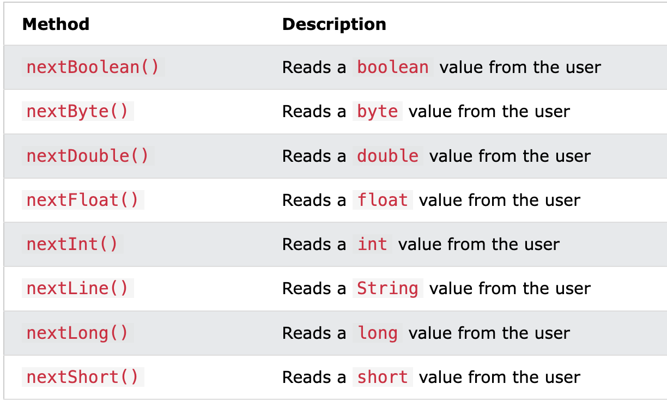
Different methods to take inputs:

Slide 27
Control Statement
Conditional Statement
If
If.. else
If .. else if… else
Switch case
Ternary operator
Loops
For loop
While loop
Do.. while loop
For each loop
Break and continue

Slide 28
Class and Objects
A class is a group of objects which have common properties.
It is a template or blueprint from which objects are created.
It is a logical entity.
To define a class in java we use a keyword class.
Syntax:
<access modifier> class <ClassName> {
// properties and methods
}
We can think of the class as a sketch (prototype) of a house. It contains all the details about the floors, doors, windows, etc. Based on these descriptions we build the house. House is the object.

Slide 29
Objects are the instances of a class that are created to use the attributes and methods of a class.
An object consists of :
State:
It is represented by attributes of an object.
It also reflects the properties of an object.
Behavior:
It is represented by the methods of an object.
It also reflects the response of an object with other objects.
Identity:
It gives a unique name to an object and enables one object to interact with other objects.

Slide 30
Constructor
A constructor is a block of code which used to initialize the object.
Every time an object is created using the new keyword, at least one constructor is called.
Types:
Default constructor
Parameterised constructor

Slide 31
Default constructor
A constructor is called "Default Constructor" when it doesn't have any parameter.
The default constructor is used to provide the default values to the object like 0, null, etc., depending on the type.
Syntax:
<class_name>(){
}
Parameterised Constructor
A constructor which has a specific number of parameters.
Used to provide different values to distinct objects.
Syntax:
<class_name> (variable1, variable 2, ….) {
}

Slide 32
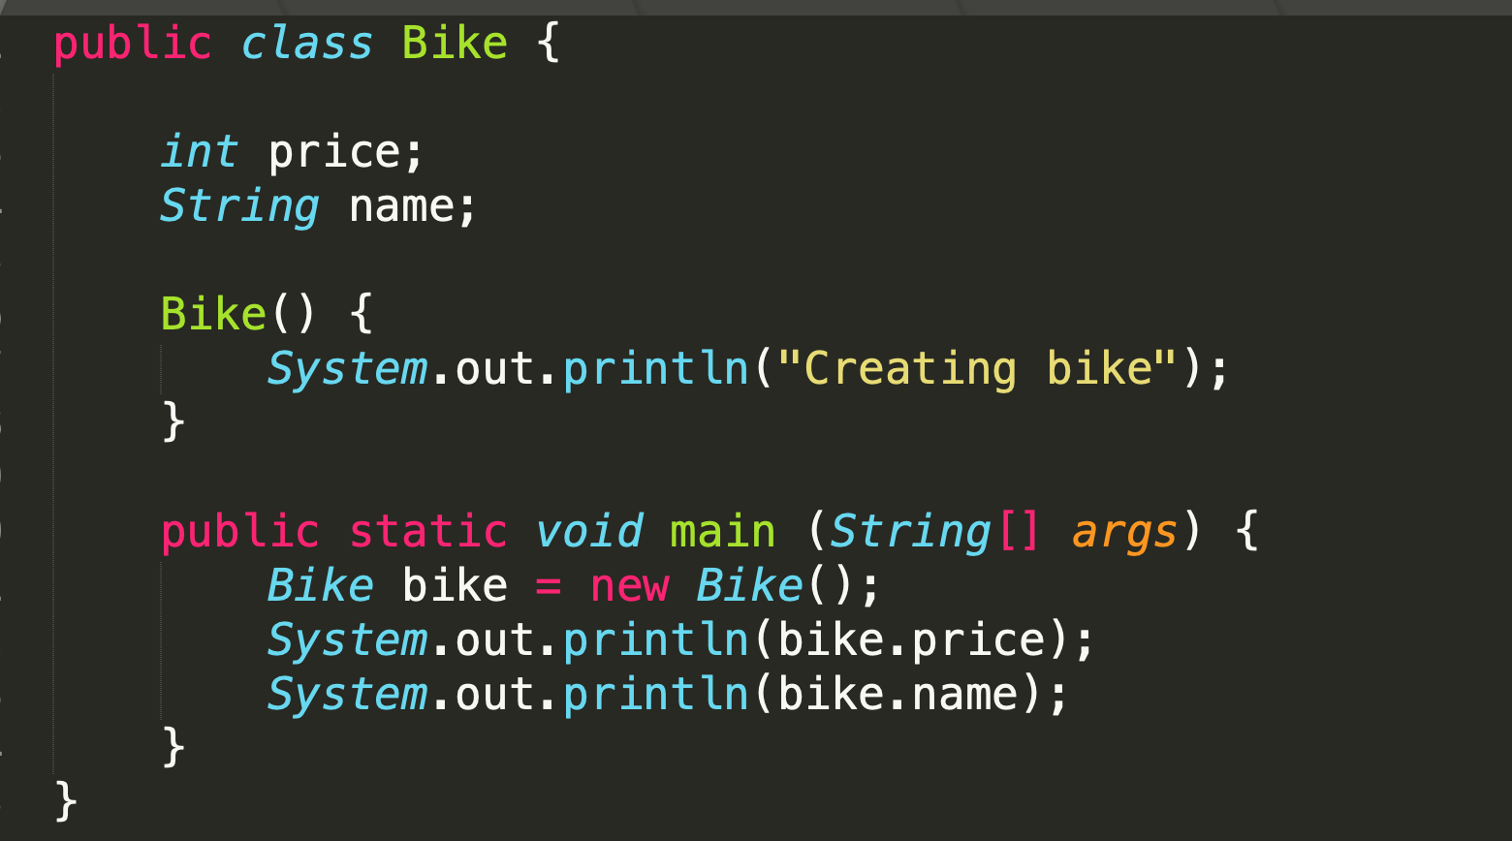

Slide 33
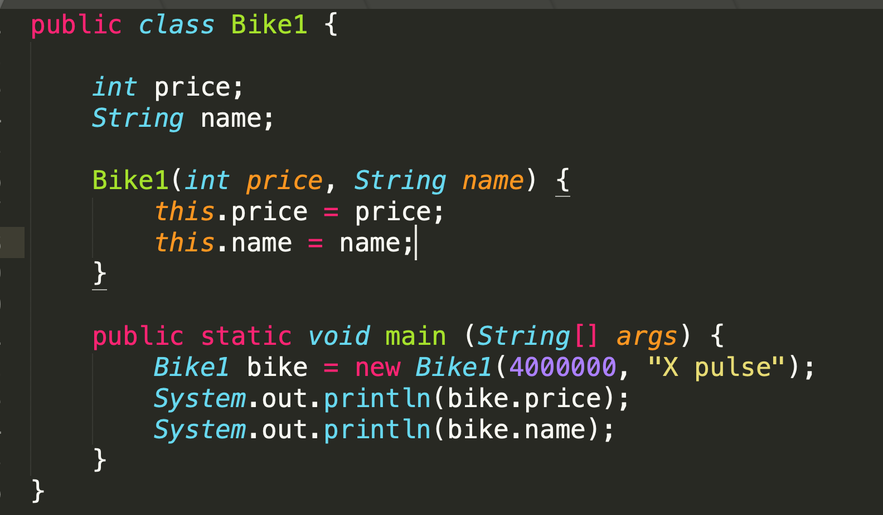

Slide 34
Constructor Overloading
Technique of having more than one constructor with different number of parameter or different data type.
They are arranged in a way that each constructor performs a different task.
They are differentiated by the compiler by the number of parameters in the list and their types.

Slide 35
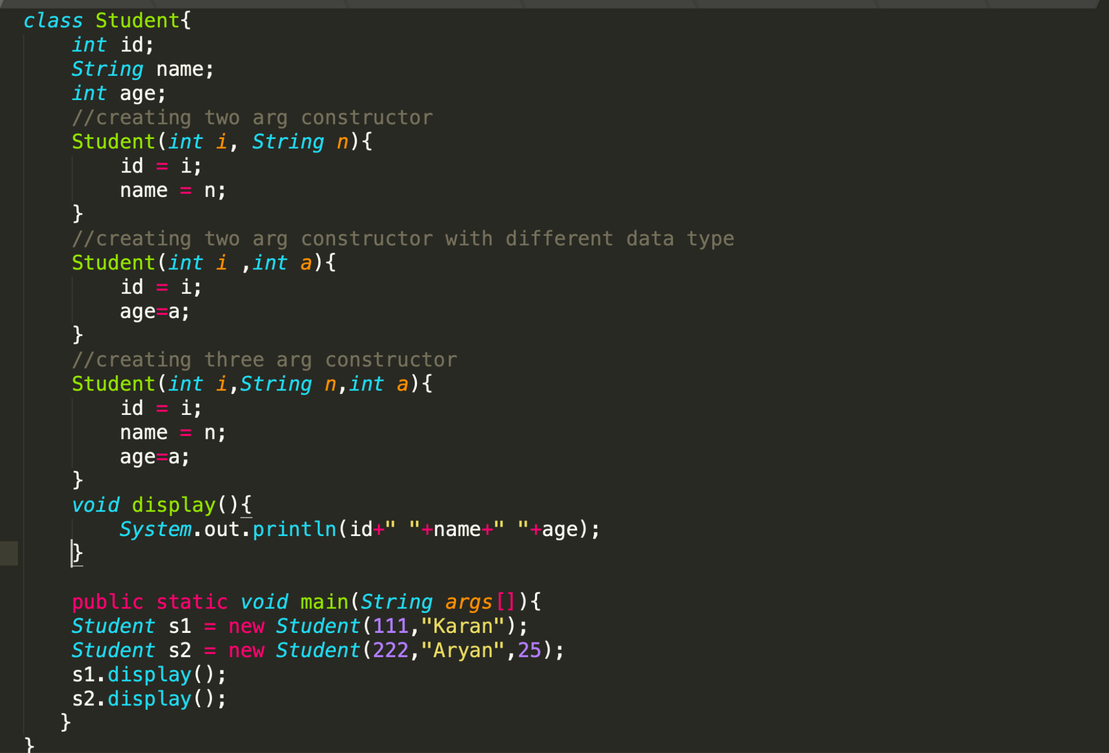

Slide 36
this Keyword in java
In Java, this is a reference variable that refers to the current object.
If there is ambiguity between the instance variables and parameters, this keyword resolves the problem of ambiguity.

Slide 37
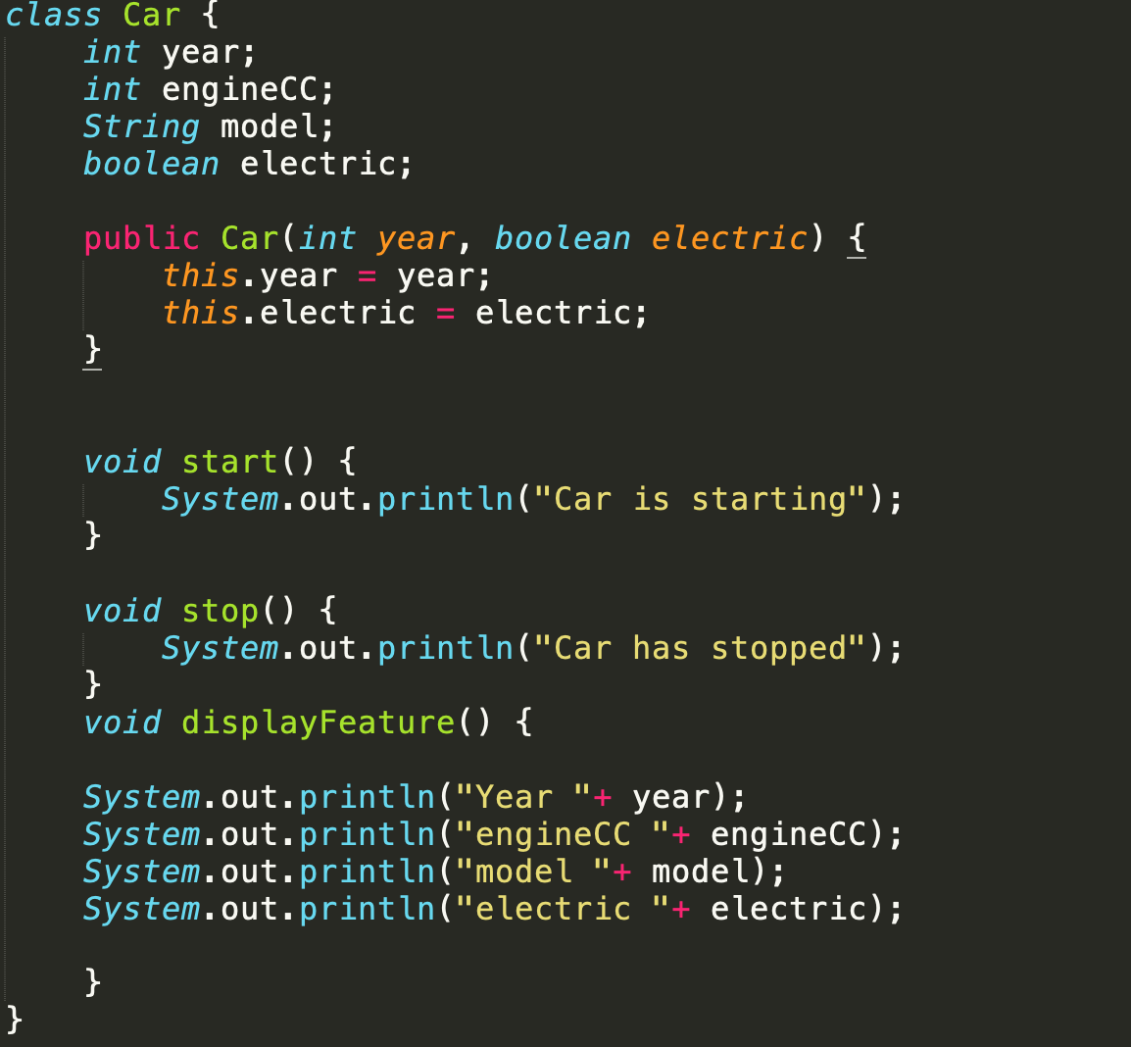

Slide 38
Inheritance
A mechanism in which one object acquires all the properties and behaviors of a parent object
When you inherit from an existing class, you can reuse methods and fields of the parent class
Moreover, you can add new methods and fields in your current class also.
Syntax:
class Subclass-name extends Superclass-name {
//methods and fields
}

Slide 39
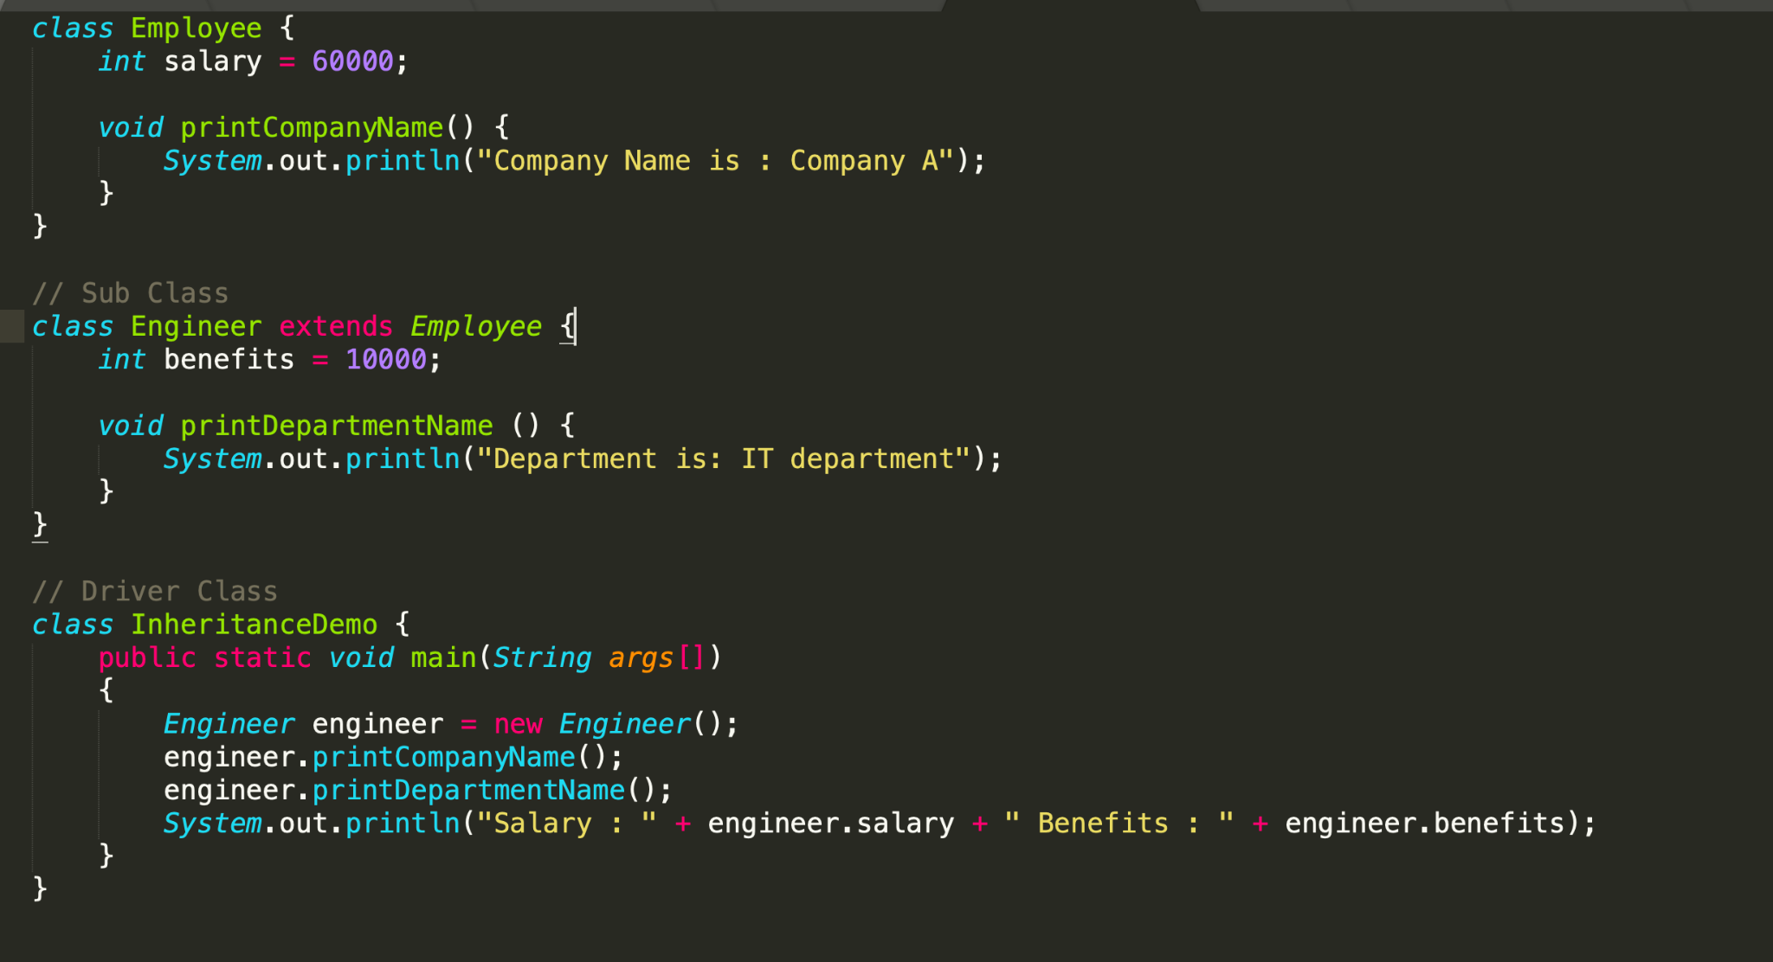

Slide 40
Super keyword in Java
super can be used to refer immediate parent class instance variable.
super can be used to invoke immediate parent class method.
super() can be used to invoke immediate parent class constructor.

Slide 41
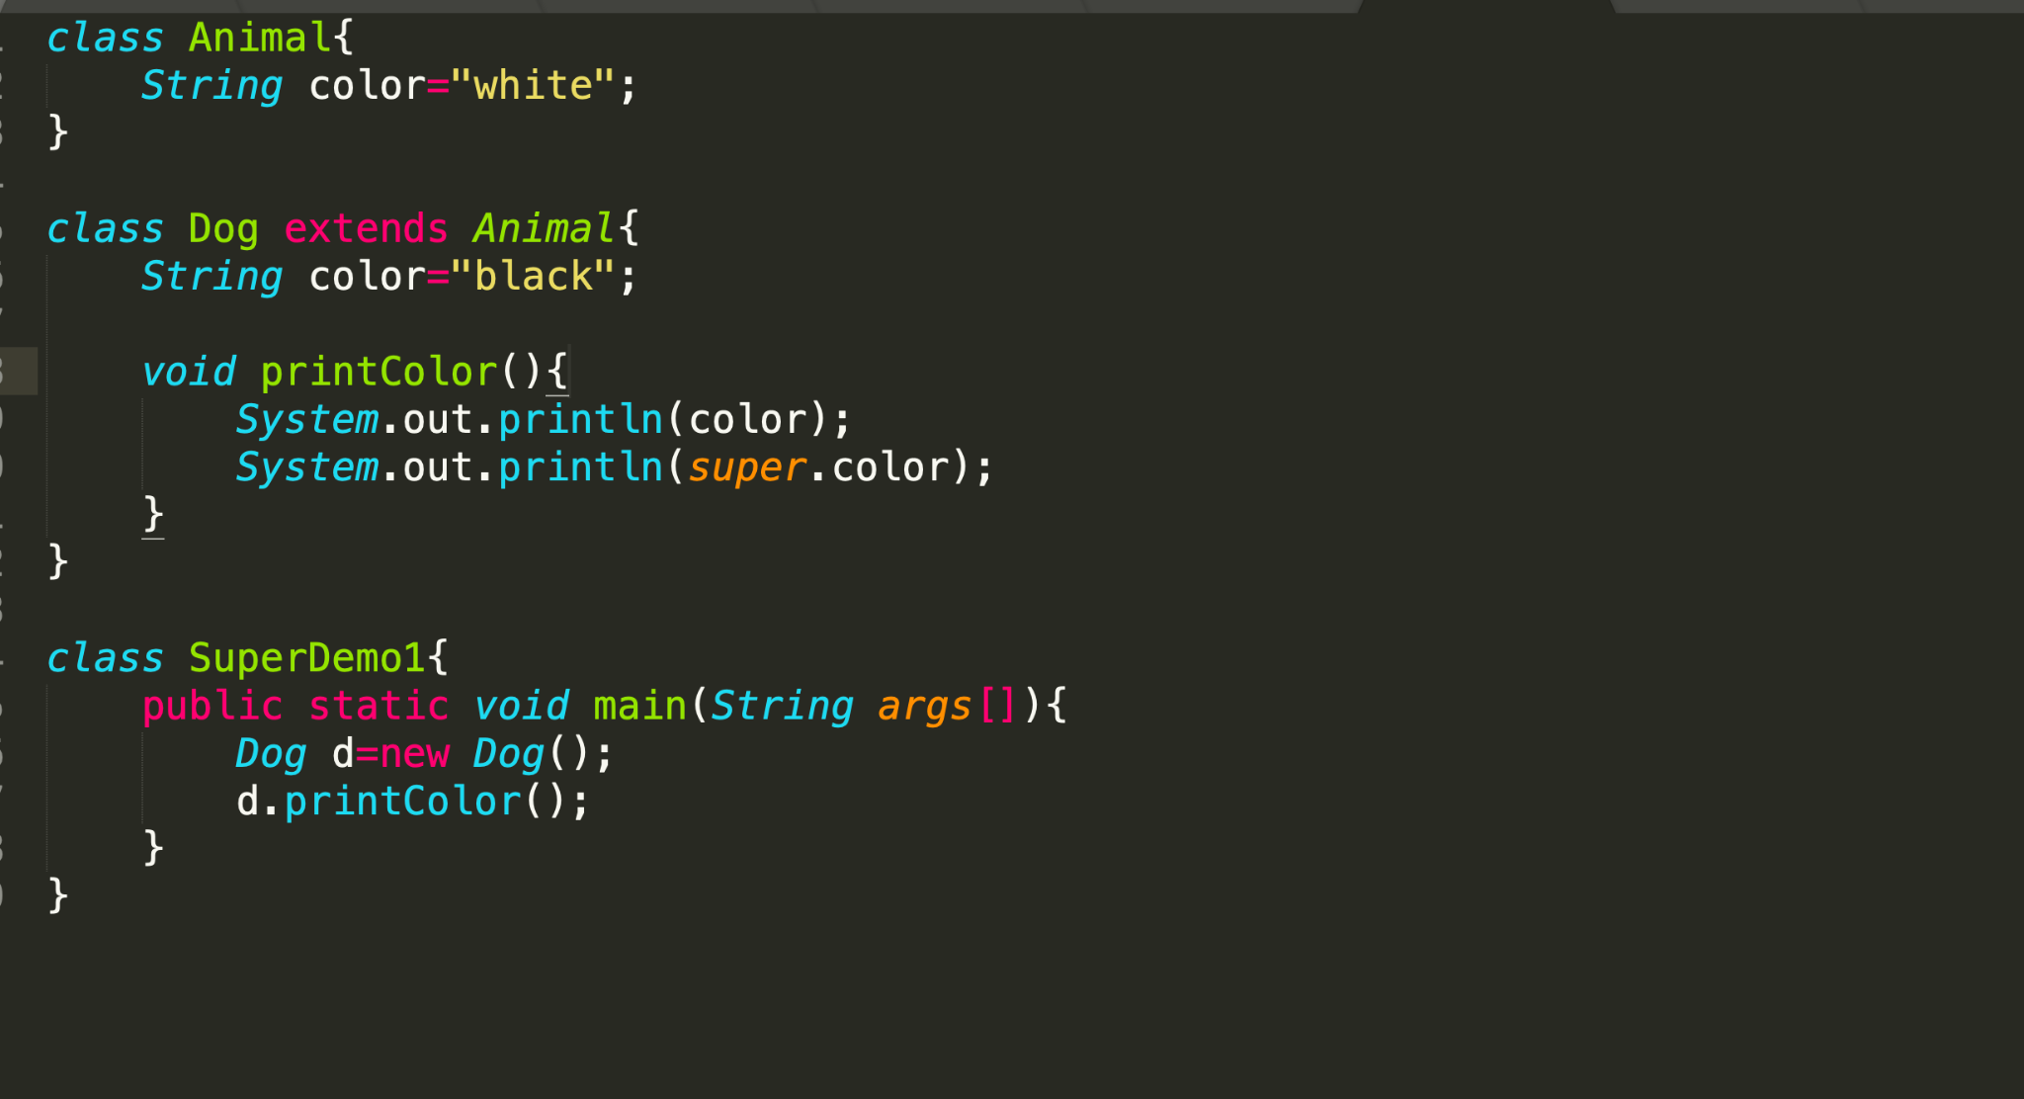

Slide 42
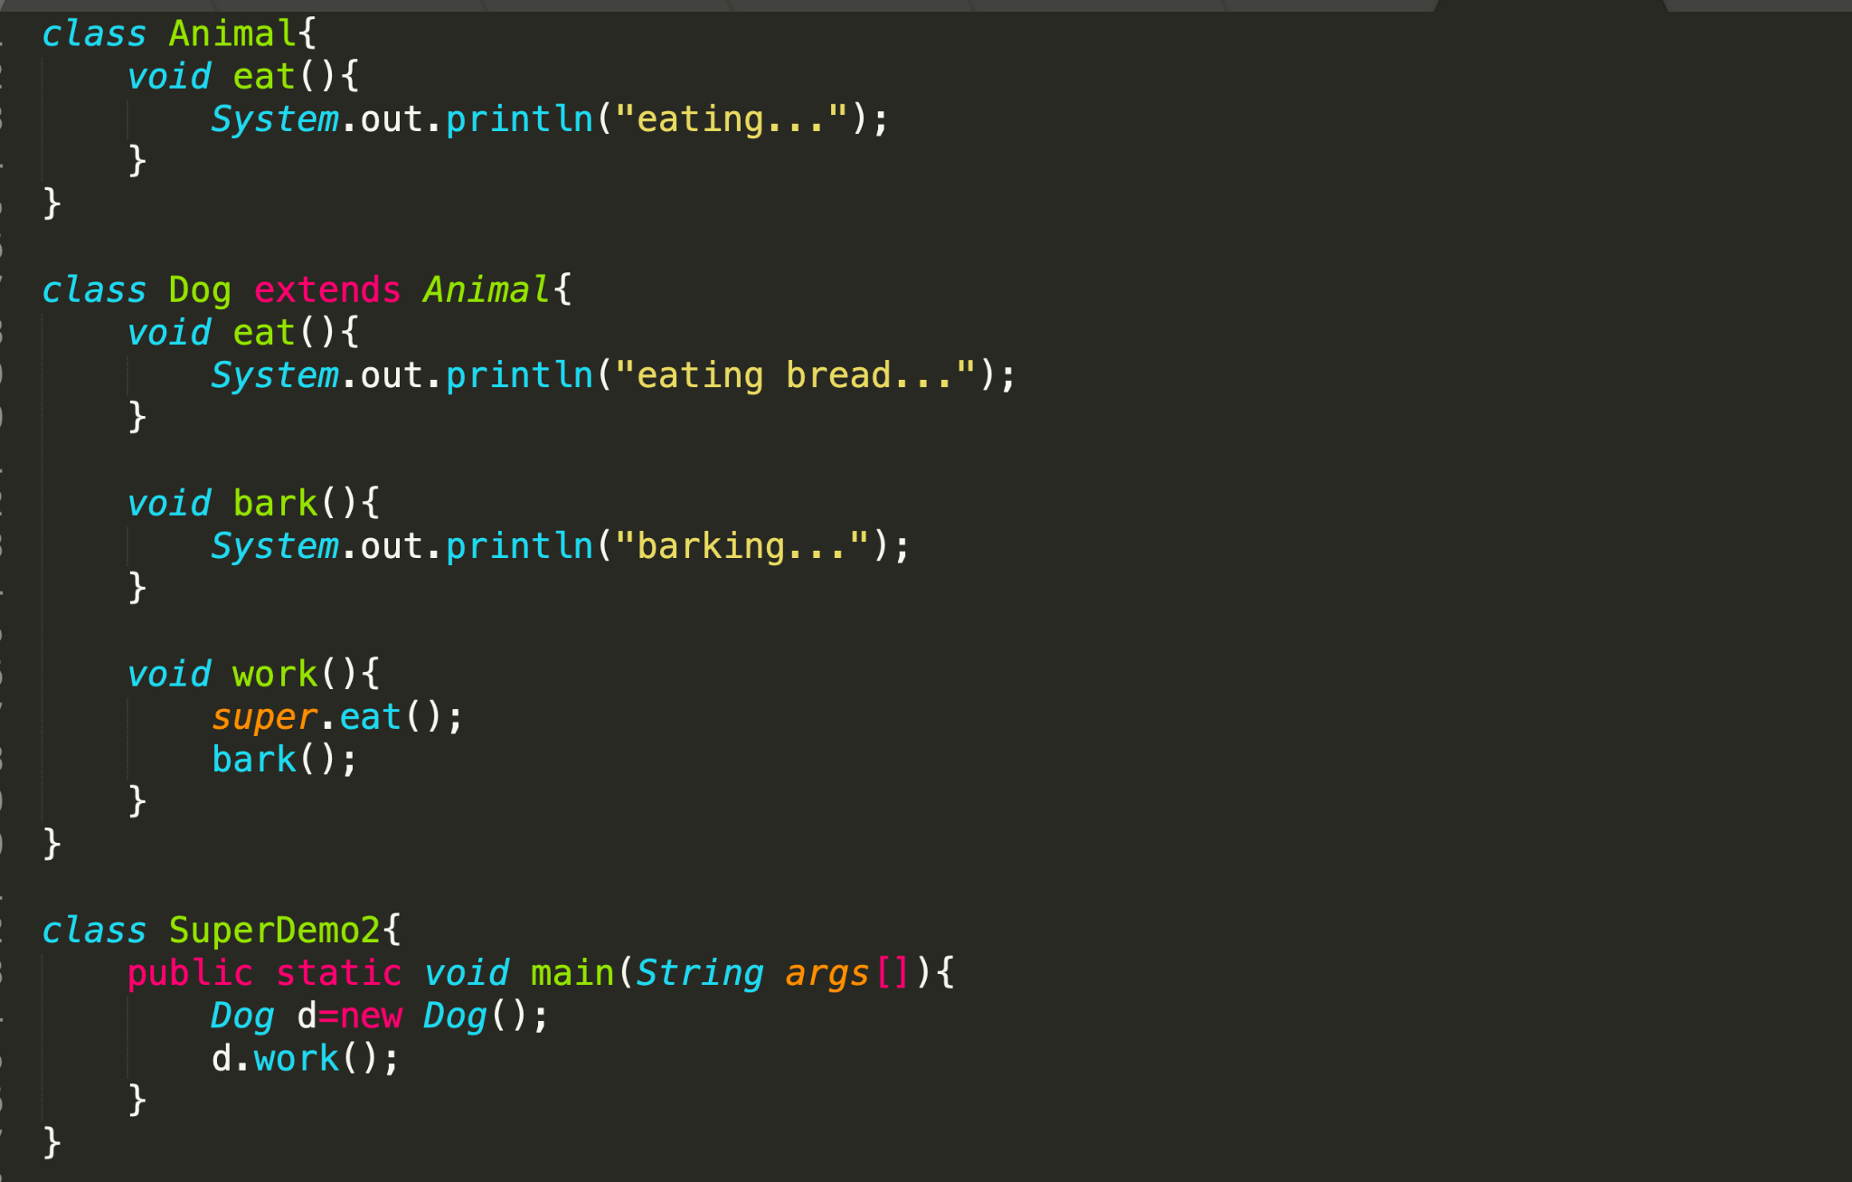

Slide 43
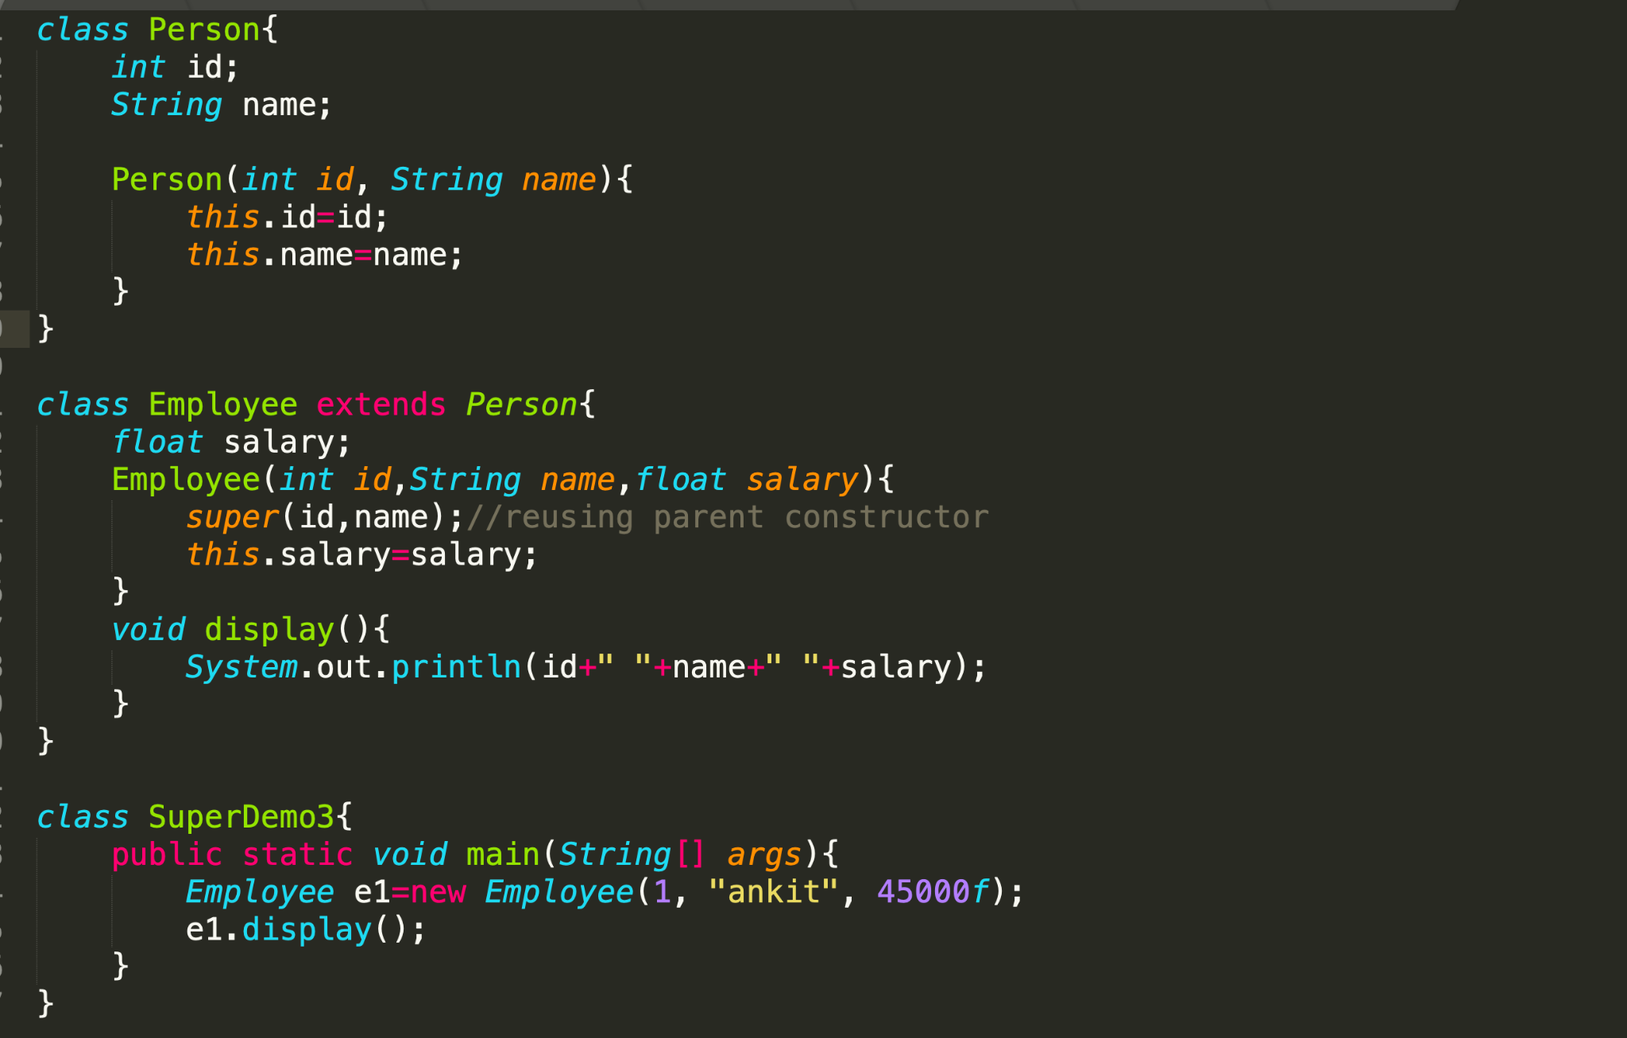

Slide 44
Polymorphism
The word polymorphism means having many forms.
Eg: A person at the same time can have different characteristics. Like a man at the same time is a father, a husband, and an employee. So the same person possesses different behaviors in different situations.
Types of Java Polymorphism
Compile-time Polymorphism
Runtime Polymorphism

Slide 45
Compile time Polymorphism
Resolved during the compilation phase of a program.
The compiler determines which function or method to invoke based on the method signatures
It is achieved by Method Overloading.
When there are multiple methods with the same name but different parameters then these methods are said to be overloaded.
Methods can be overloaded by changes in the number of arguments or/and a change in the type of arguments.

Slide 46
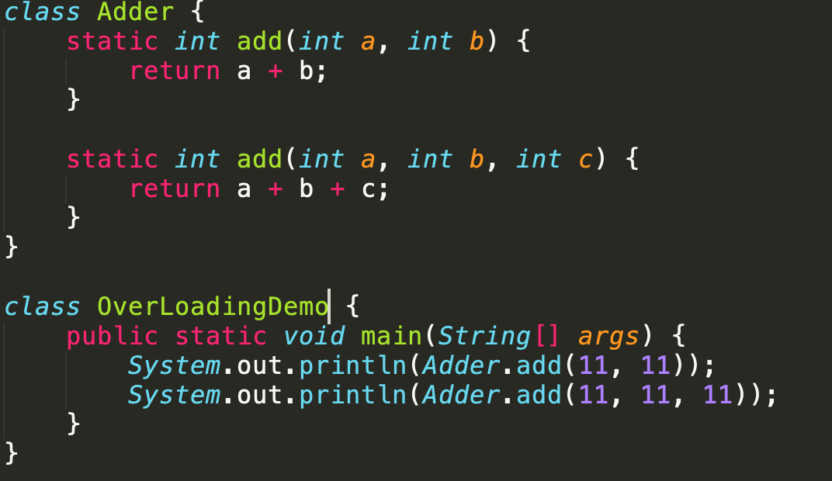

Slide 47
Runtime Polymorphism
Resolved at runtime rather than compile-time.
It is achieved by Method overriding.
If subclass (child class) has the same method as declared in the parent class, it is known as method overriding in Java.
If a subclass provides the specific implementation of the method that has been declared by one of its parent class, it is known as method overriding.

Slide 48
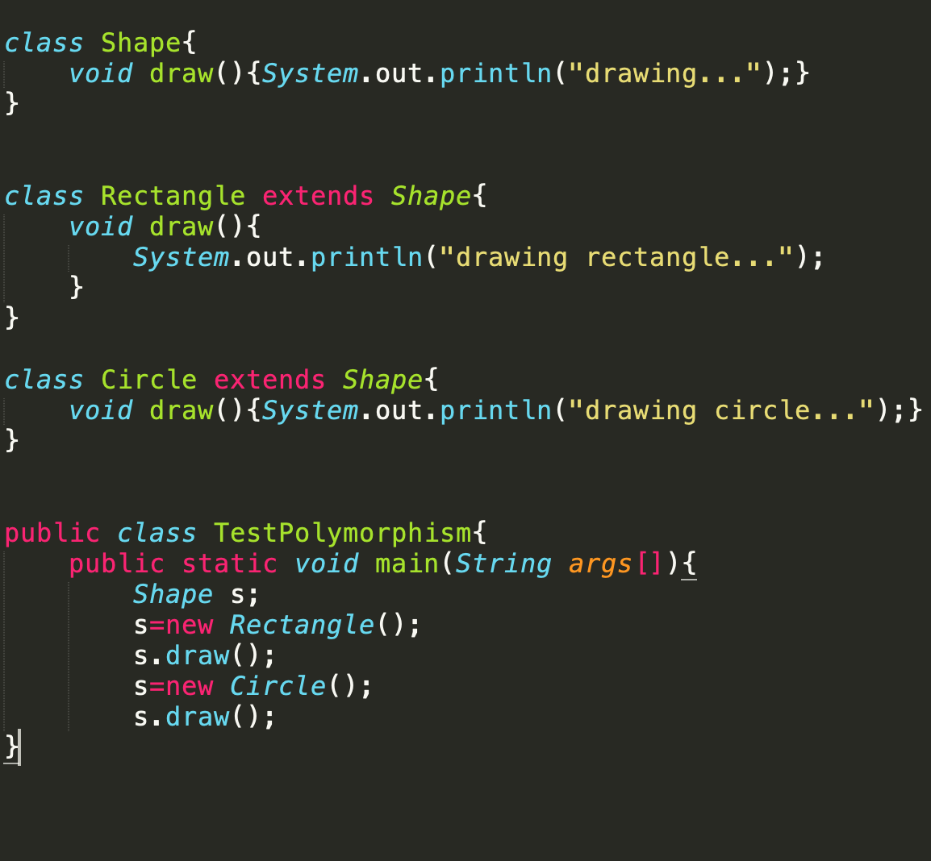

Slide 49
Package
A java package is a group of similar types of classes, interfaces and sub-packages.
Package in java can be categorized in two form, built-in package and user-defined package.
There are many built-in packages such as java, lang, awt, javax, swing, net, io, util, sql etc.

Slide 50
package mypack;
public class PackageDemo{
public static void main(String args[]){
System.out.println("Welcome to package");
}
}

Slide 51
Compiling:
javac -d directoryname filename
⇒ javac -d . PackageDemo.java
Running the program:
java packagename.Classname
⇒ java myPack.PackageDemo

Slide 52
Access modifier
Private:
The access level of a private modifier is only within the class.
It cannot be accessed from outside the class.
Default:
The access level of a default modifier is only within the package.
It cannot be accessed from outside the package. If you do not specify any access level, it will be the default.
Protected:
The access level of a protected modifier is within the package and outside the package through child class.
If you do not make the child class, it cannot be accessed from outside the package.
Public:
The access level of a public modifier is everywhere.
It can be accessed from within the class, outside the class, within the package and outside the package.

Slide 53
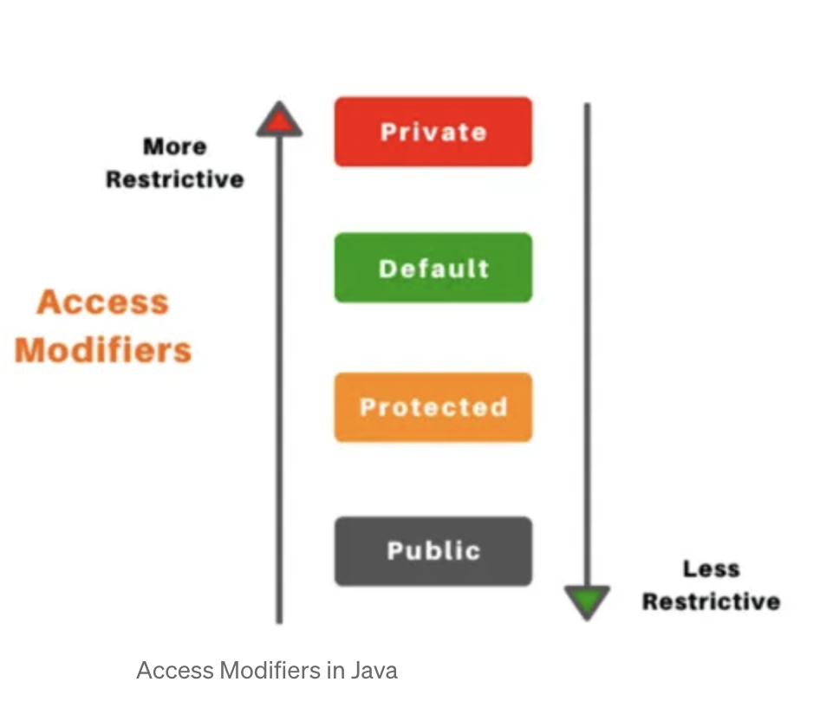
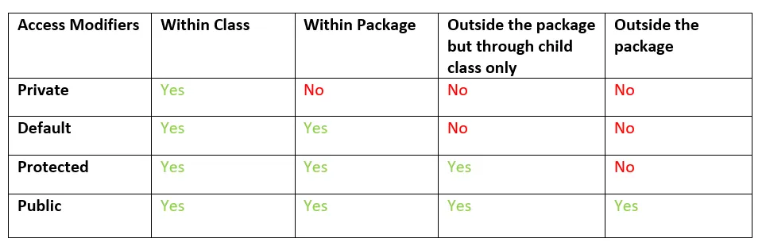

Slide 54
final keyword
The final keyword is used to indicate that a variable, method, or class cannot be modified or extended.
Some of its characteristics:
Final variables:
When a variable is declared as final, its value cannot be changed once it has been initialized.
This is useful for declaring constants or other values that should not be modified.
Final methods:
When a method is declared as final, it cannot be overridden by a subclass.
This is useful for methods that are part of a class and should not be modified by subclasses.
Final classes:
When a class is declared as final, it cannot be extended by a subclass.
This is useful for classes that are intended to be used as is and should not be modified or extended.
Initialization:
Final variables must be initialized either at the time of declaration or in the constructor of the class.
This ensures that the value of the variable is set and cannot be changed.

Slide 55
Interface
The interface in Java is a mechanism to achieve abstraction.
There can be only abstract methods in the Java interface, not the method body.
It is used to achieve abstraction and multiple inheritances in Java using Interface.
Since java does not support multiple inheritances in the case of class, by using an interface it can achieve multiple inheritances.
Any class can extend only 1 class but can any class implement an infinite number of interface.
It is also used to achieve loose coupling.

Slide 56
Abstract class
A class which is declared with the abstract keyword is known as an abstract class in Java.
An abstract class must be declared with an abstract keyword.
It can have abstract and non-abstract methods.
It cannot be instantiated.
It can have constructors and static methods also.
It can have final methods which will force the subclass not to change the body of the method.

Slide 57
Exception Handling
Exception is an unwanted or unexpected event, which occurs during the execution of a program that disrupts the normal flow of the program.
It is an object which is thrown at runtime.
When an exception occurs within a method, it creates an object called the exception object.

Slide 58
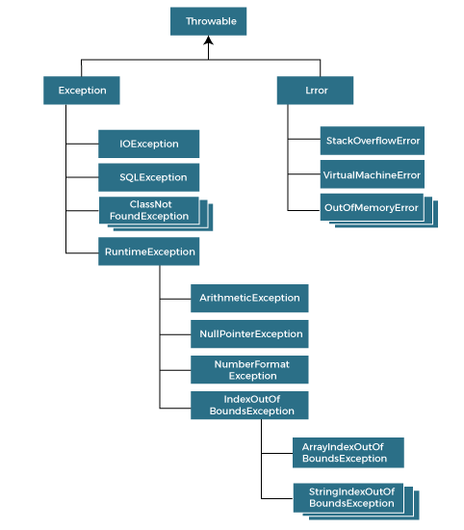

Slide 59
Types of exception
Checked Exception
The classes that directly inherit the Throwable class except RuntimeException and Error are known as checked exceptions. For example, IOException, SQLException, etc. Checked exceptions are checked at compile-time.
Unchecked Exception
The classes that inherit the RuntimeException are known as unchecked exceptions.
Unchecked exceptions are not checked at compile-time, but they are checked at runtime.
Error
Error is irrecoverable.

Slide 60
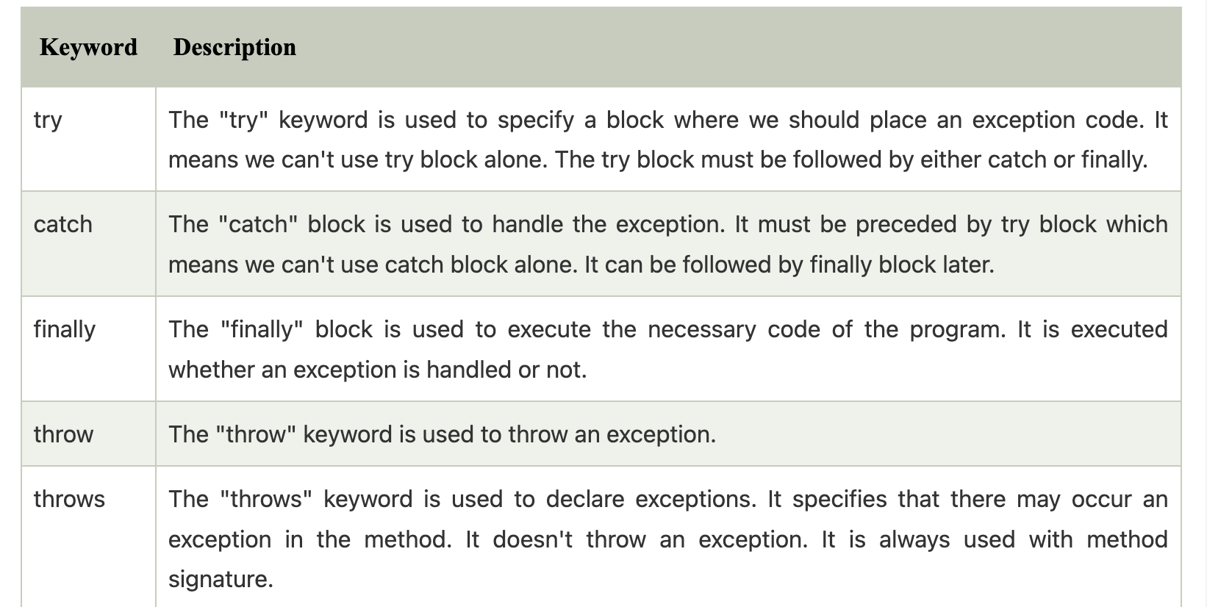

Slide 61
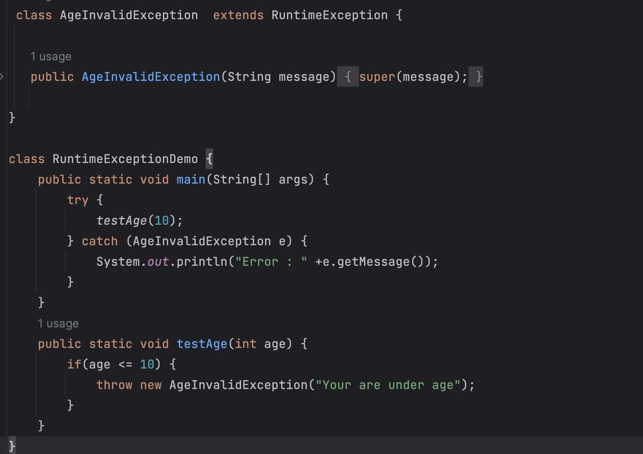

Slide 62
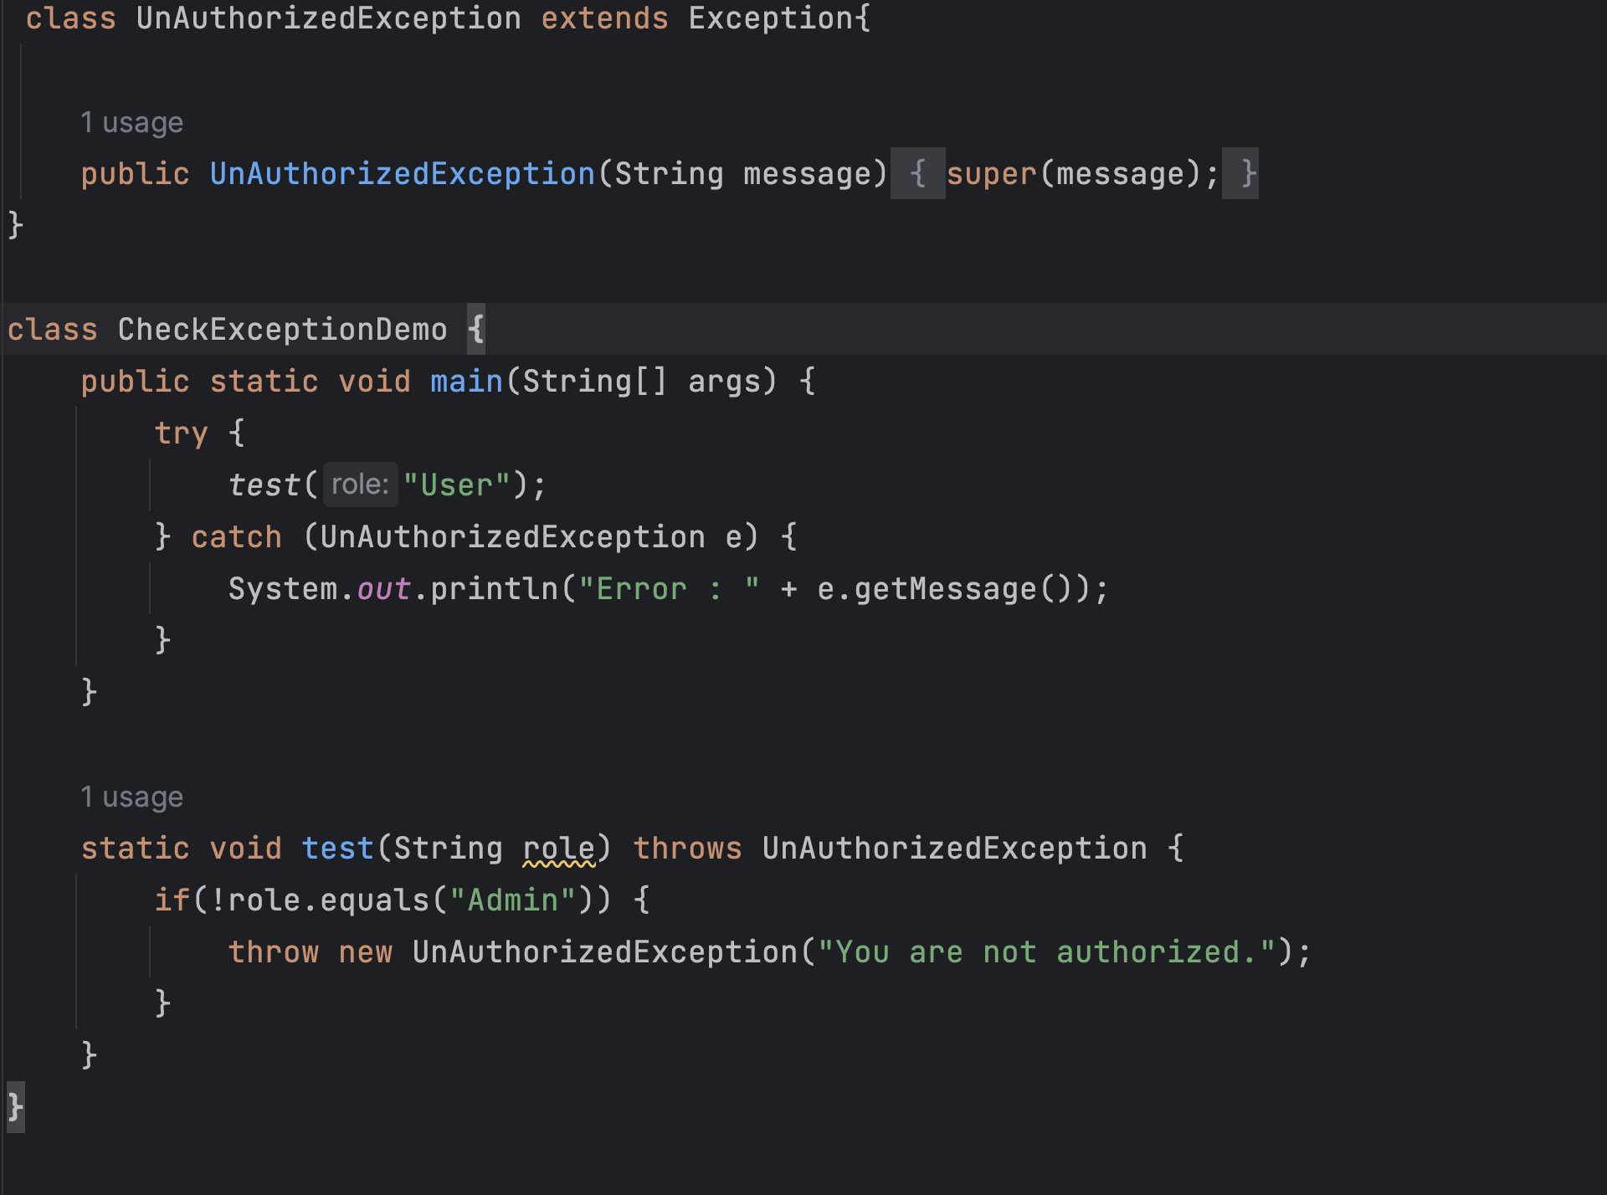

Slide 63
Multithreading in java
The process of executing multiple threads simultaneously is known as multithreading.
The main purpose of multithreading si ot provide simultaneous execution of two or more parts of a program to maximum utilize the CPU time.
A multithreaded program contains two or more parts that can run concurrently.
Each such part of a program called thread.

Slide 64
Two ways of creating Thread
Threads can be created by using two mechanisms :
Extending the Thread class
Implementing the Runnable Interface

Slide 65
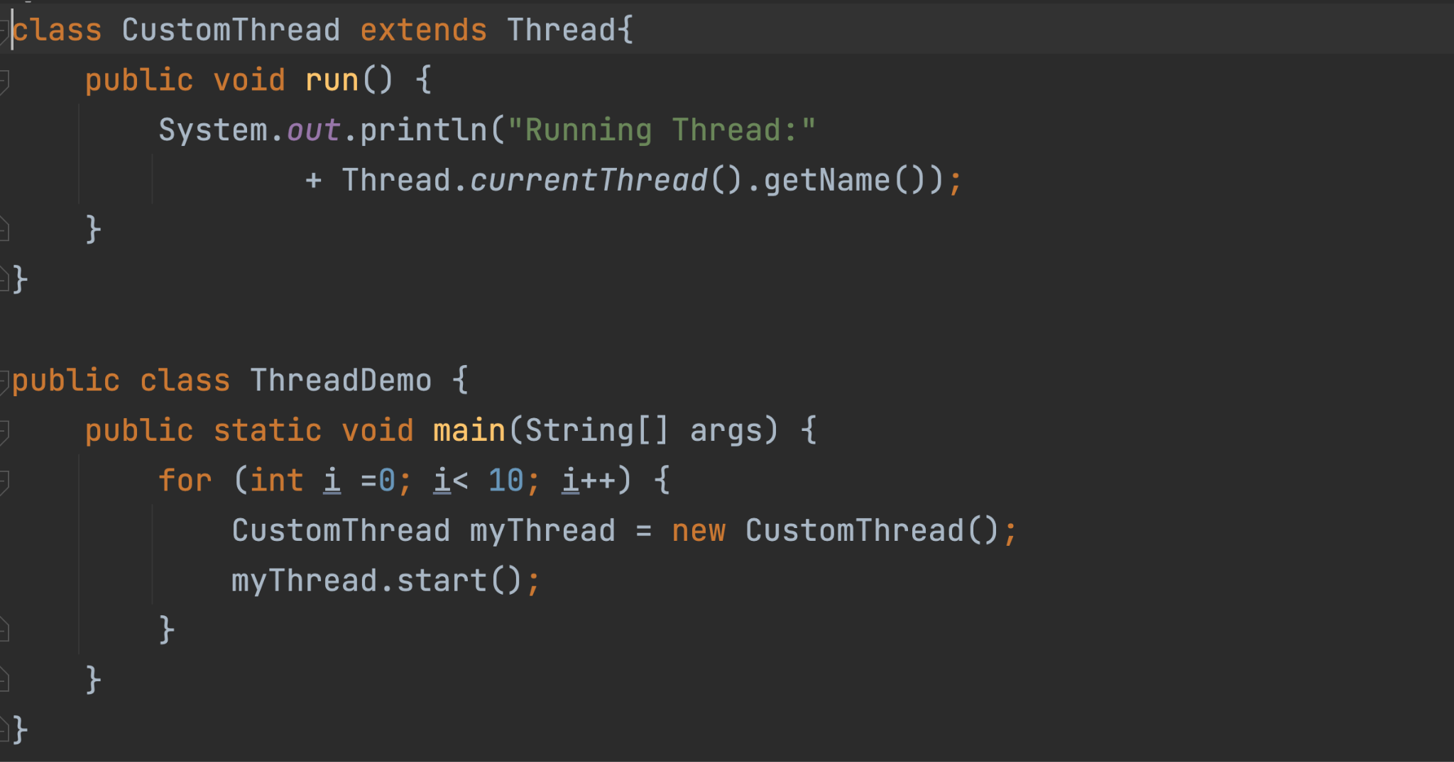

Slide 66
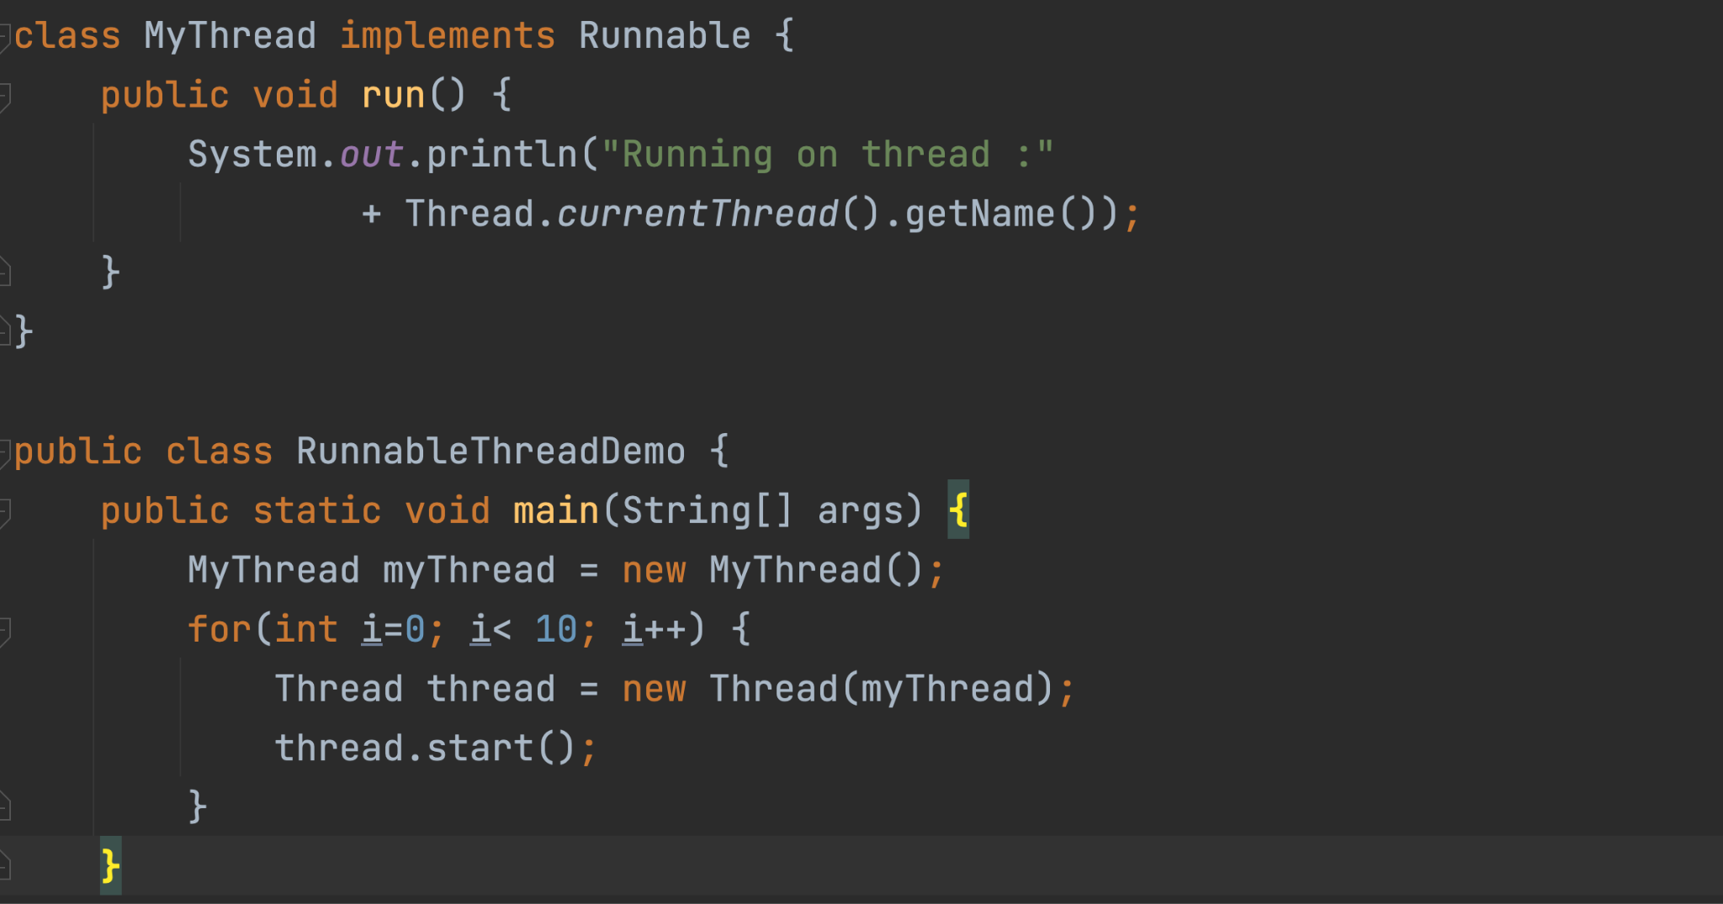

Slide 67
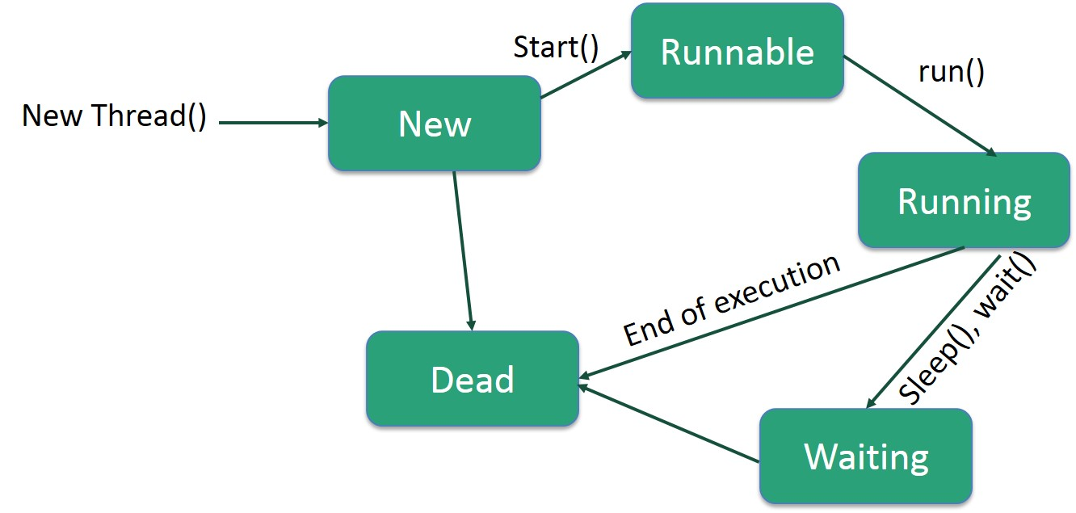

Slide 68
Thread Synchronization
Synchronization in Java is the capability to control the access of multiple threads to any shared resource.
The synchronization is mainly used to
To prevent thread interference.
To prevent consistency problem.
Thread Synchronization can be achieved with:
By Using Synchronized Method
By Using Synchronized Block
By Using Static Synchronization

Slide 69
Thread Priority
Each thread has a priority.
Priorities are represented by a number between 1 and 10.
The thread scheduler schedules the threads according to their priority
But it is not guaranteed because it depends on JVM specification that which scheduling it chooses.
3 constants defined in Thread class:
MIN_PRIORITY
NORM_PRIORITY
MAX_PRIORITY
Default priority of a thread is 5 (NORM_PRIORITY). The value of MIN_PRIORITY is 1 and the value of MAX_PRIORITY is 10.

Slide 70
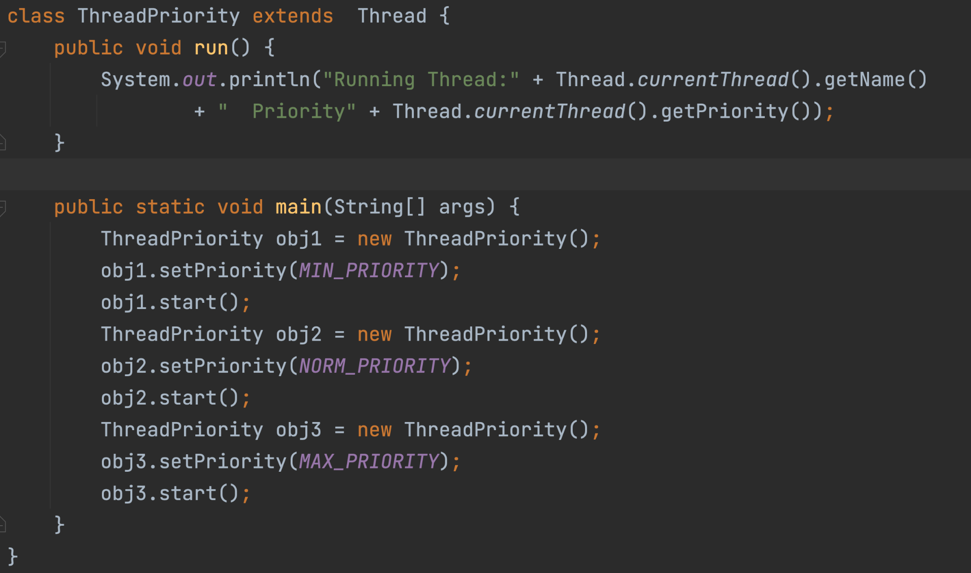

Slide 71
File Handling
In simple words, file handling means reading and writing data to a file.
File Handling is an integral part of any programming language as file handling enables us to store the output of any particular program in a file and allows us to perform certain operations on it.
In Java, the concept Stream is used in order to perform I/O operations on a file.
A sequence of data is known as a stream.
There are two types of streams :
Input Stream
Output Stream

Slide 72
InputStream
The InputStream class provides methods to read bytes from a file, console or memory.
It is an abstract class and can't be instantiated.
However, various classes inherit the InputStream class and override its methods.
Sub classes:

Slide 73
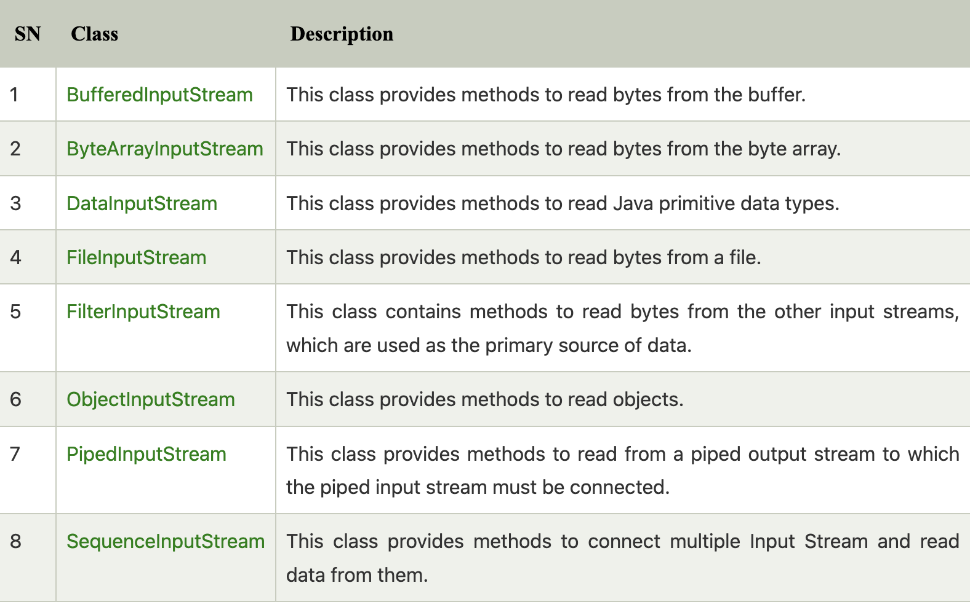

Slide 74
OutputStream Class
The OutputStream is an abstract class that is used to write 8-bit bytes to the stream.
It is the superclass of all the output stream classes.
This class can't be instantiated.
It is inherited by various subclasses

Slide 75
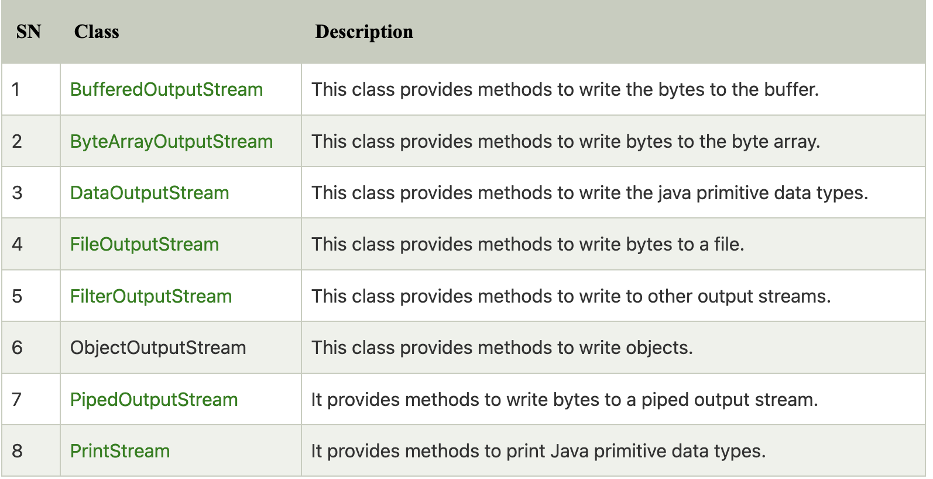

Slide 76
FileOutputStream
FileOutputStream is an outputstream for writing data/streams of raw bytes to file or storing data to file.
FileOutputStream is a subclass of OutputStream.
To write primitive values into a file, we use FileOutputStream class.
For writing byte-oriented and character-oriented data, we can use FileOutputStream
But for writing character-oriented data, FileWriter is more preferred.

Slide 77
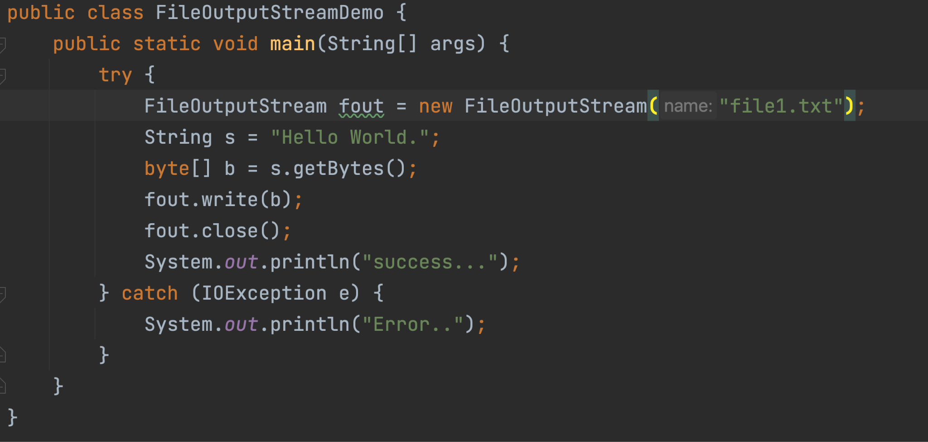

Slide 78
FileInputStream
FileInputStream class is useful to read data from a file in the form of sequence of bytes.
FileInputStream is meant for reading streams of raw bytes such as image data.
But, For reading streams of characters, consider using FileReader.

Slide 79
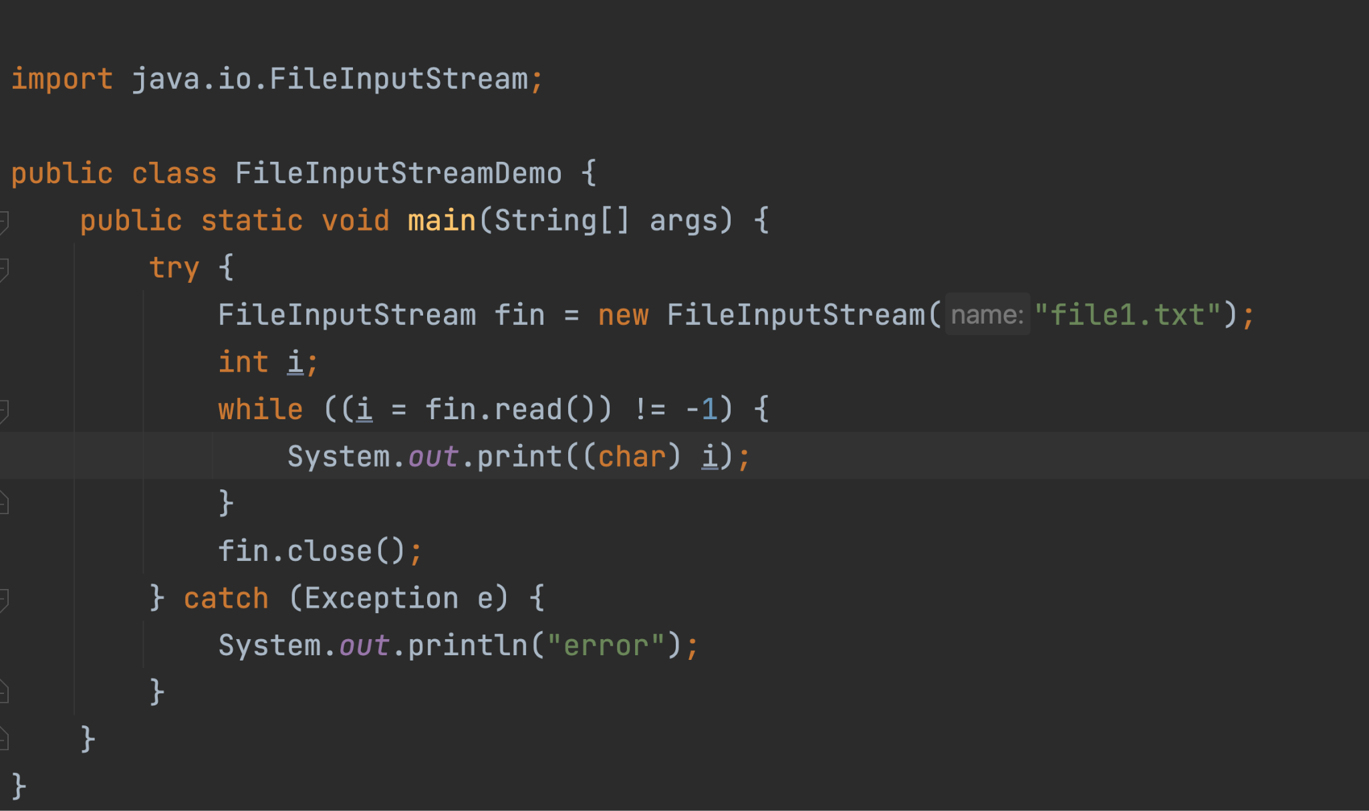

Slide 80
Character Stream
CharacterStream classes are mainly used to read characters from the source and write them to the destination.
CharacterStream classes are used to work with 16-bit Unicode characters. They can perform operations on characters, char arrays and Strings.
CharacterStream classes are divided into two types of classes:
Reader class
Writer class

Slide 81
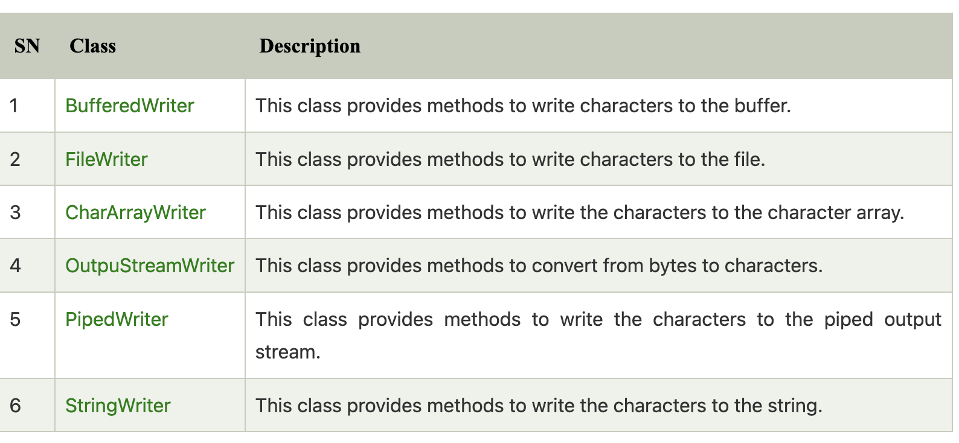

Slide 82
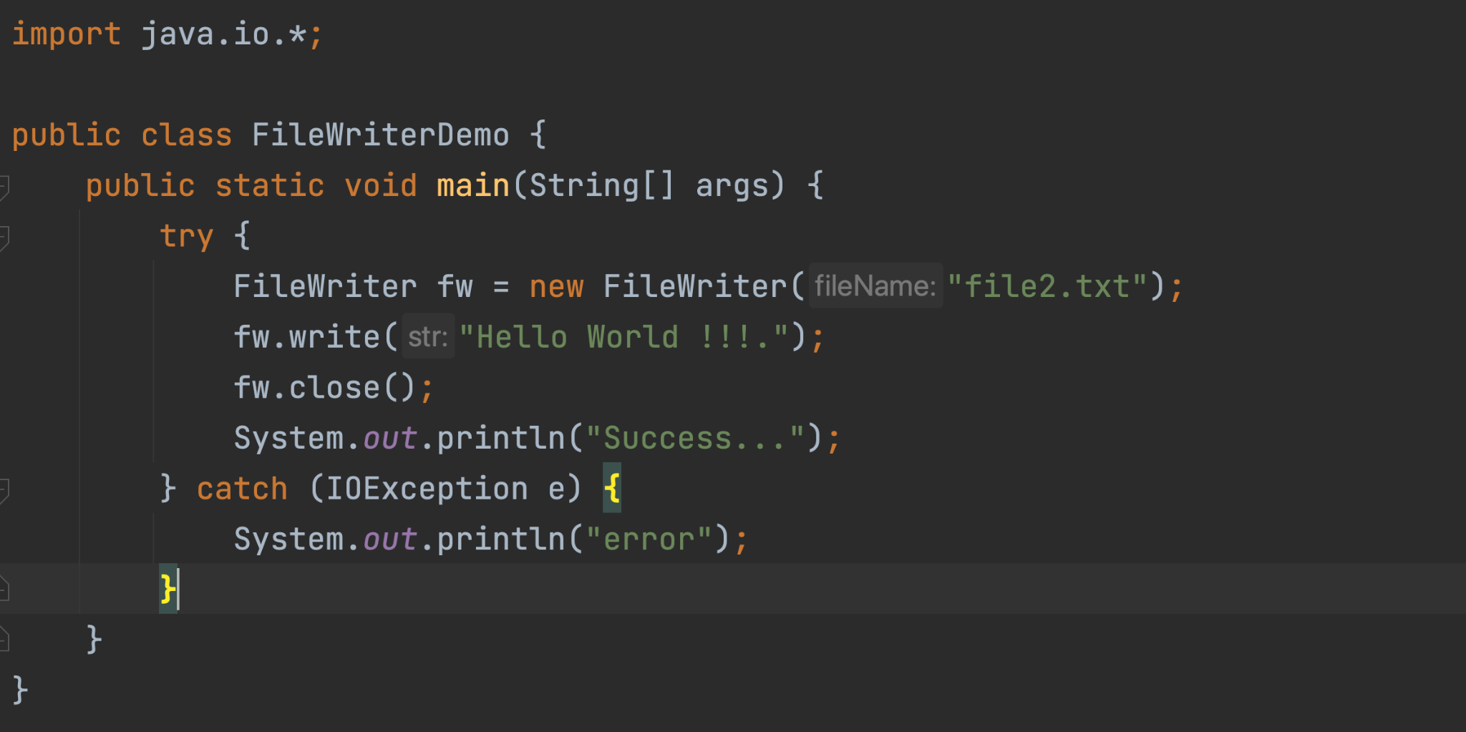

Slide 83
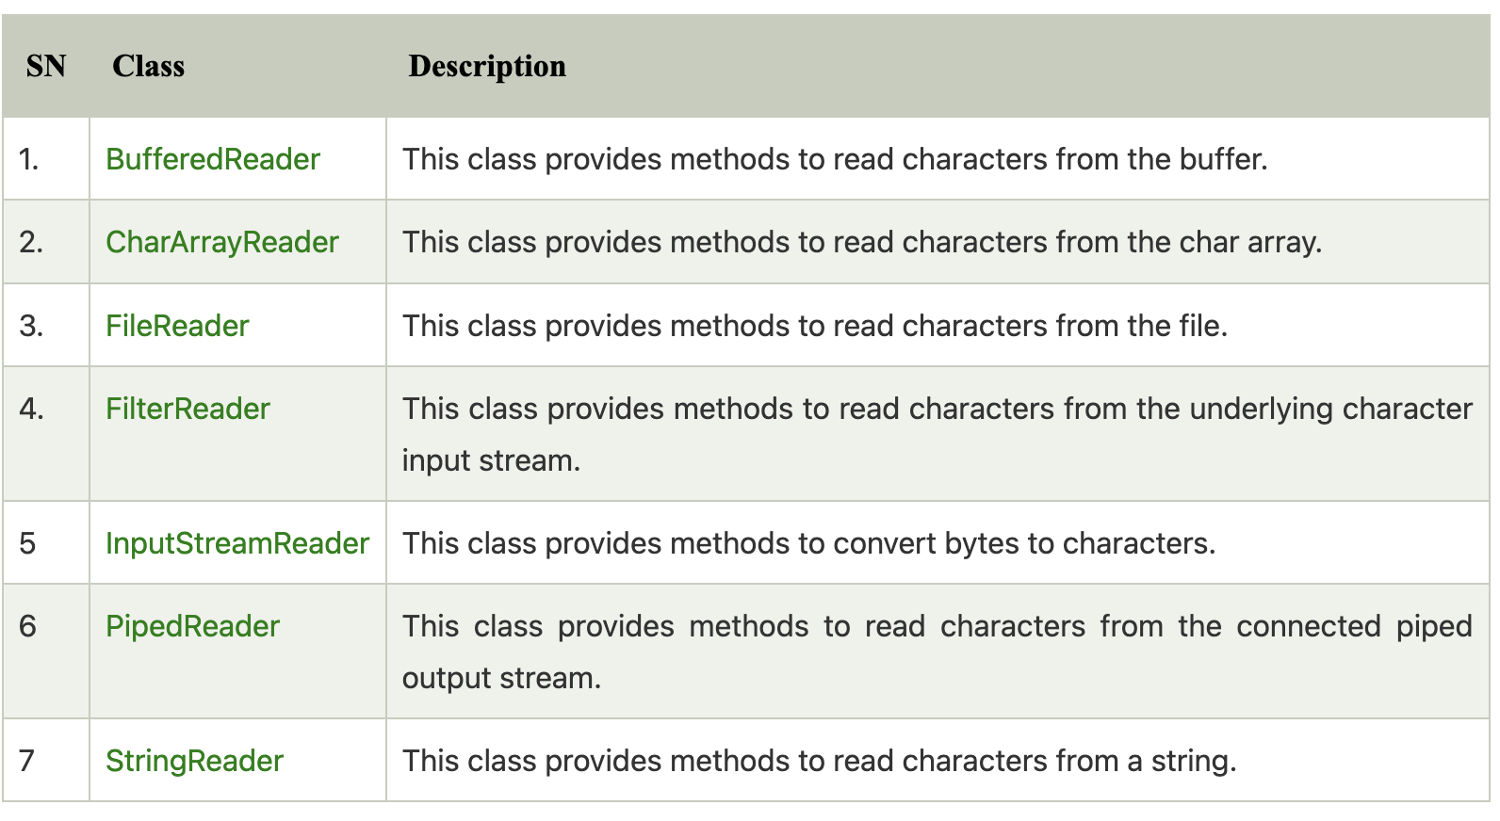

Slide 84
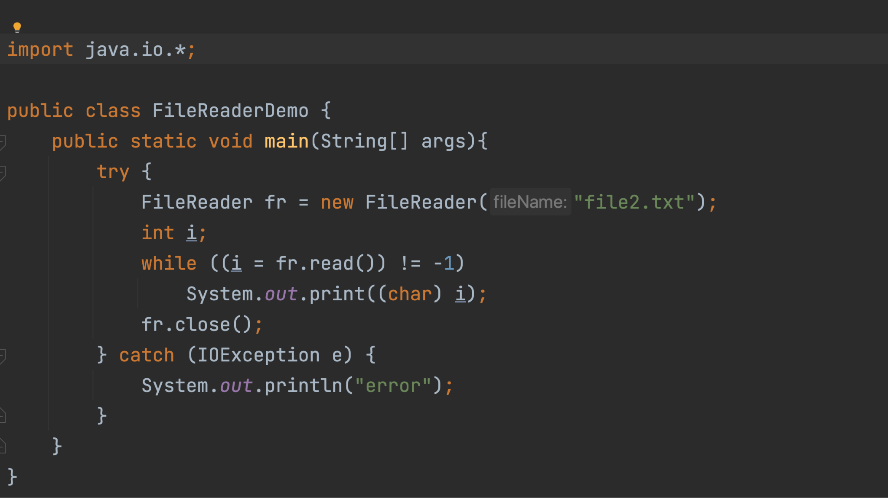

Slide 85
Reading and writing object to file

Slide 86
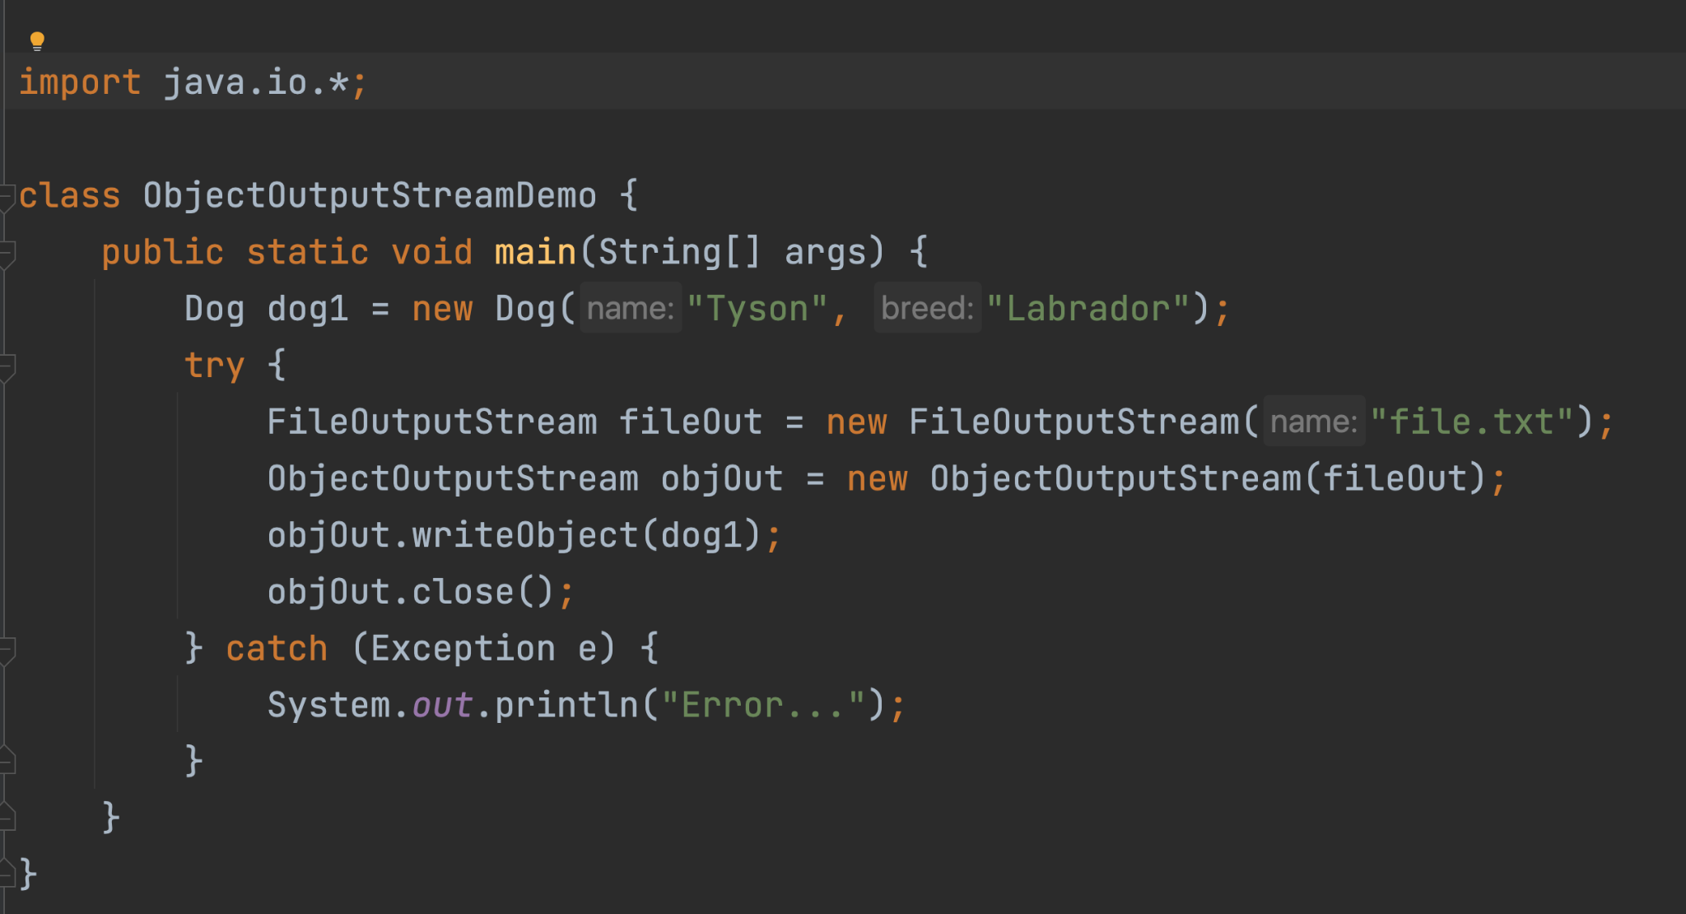

Slide 87
